Slide 1
Activity: Modeling ecosystem successional patterns in response to disturbances
  Create a folder for this activity, and name it as desired, be sure to save it where you want, which could be on the desktop, within another folder in the computer, or on google docs. It is important to save this where you will be able to find it (not on the downloads folder).
  Download all the files provided for this activity and save them in the folder.
  Open a new Word document and save it in the folder. This document is where you will paste all your output and respond to questions as part of the assignment for this activity. Once you start the activities, remember to keep saving this Word document frequently so you do not lose your work.

Slide 2
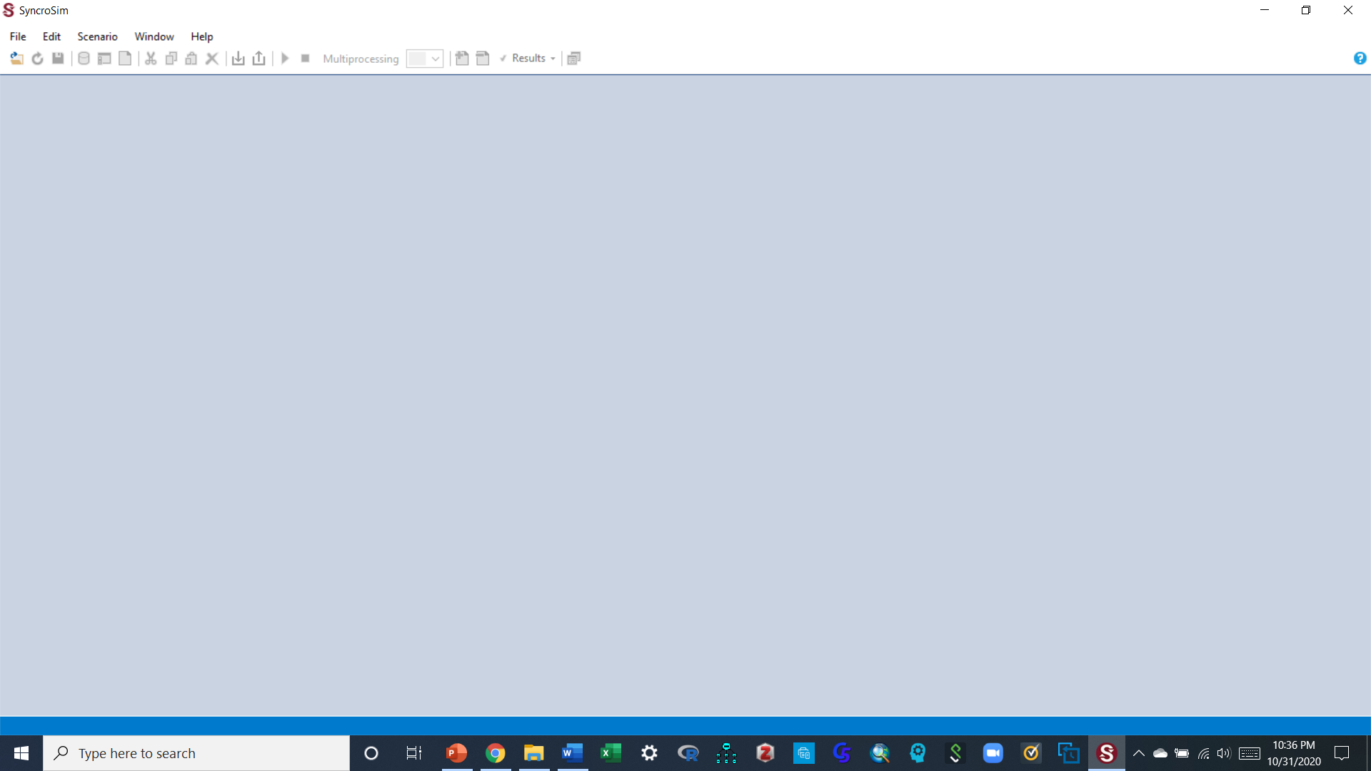
To begin:
Open SyncroSim by clicking the windows tab on your computer and clicking apps to select it from the list of apps, or by searching for it using the search box that is right next to your windows tab.
When open, your workspace should look something similar to the screen below, when SyncroSim is opened for the first time.
  If you had worked on SyncroSim before on the same computer, and are opening it again after that initial time, files from previous work may have been saved in the workspace and will show up on the library explorer pane to the left of the screen.
  If this happens, delete these file(s) by right clicking each and selecting “close” in the options that come up.
  Once that pane has no files in it, click the red x tab to the top right corner of that pane to remove the pane, then click the save tab in the list of tabs at the top panel to save these settings. This will leave the workspace clear as shown in the image below.

Slide 3
Part 1: Understanding the SyncroSim modeling environment and displaying normal succession classes in your ecosystem

Slide 4
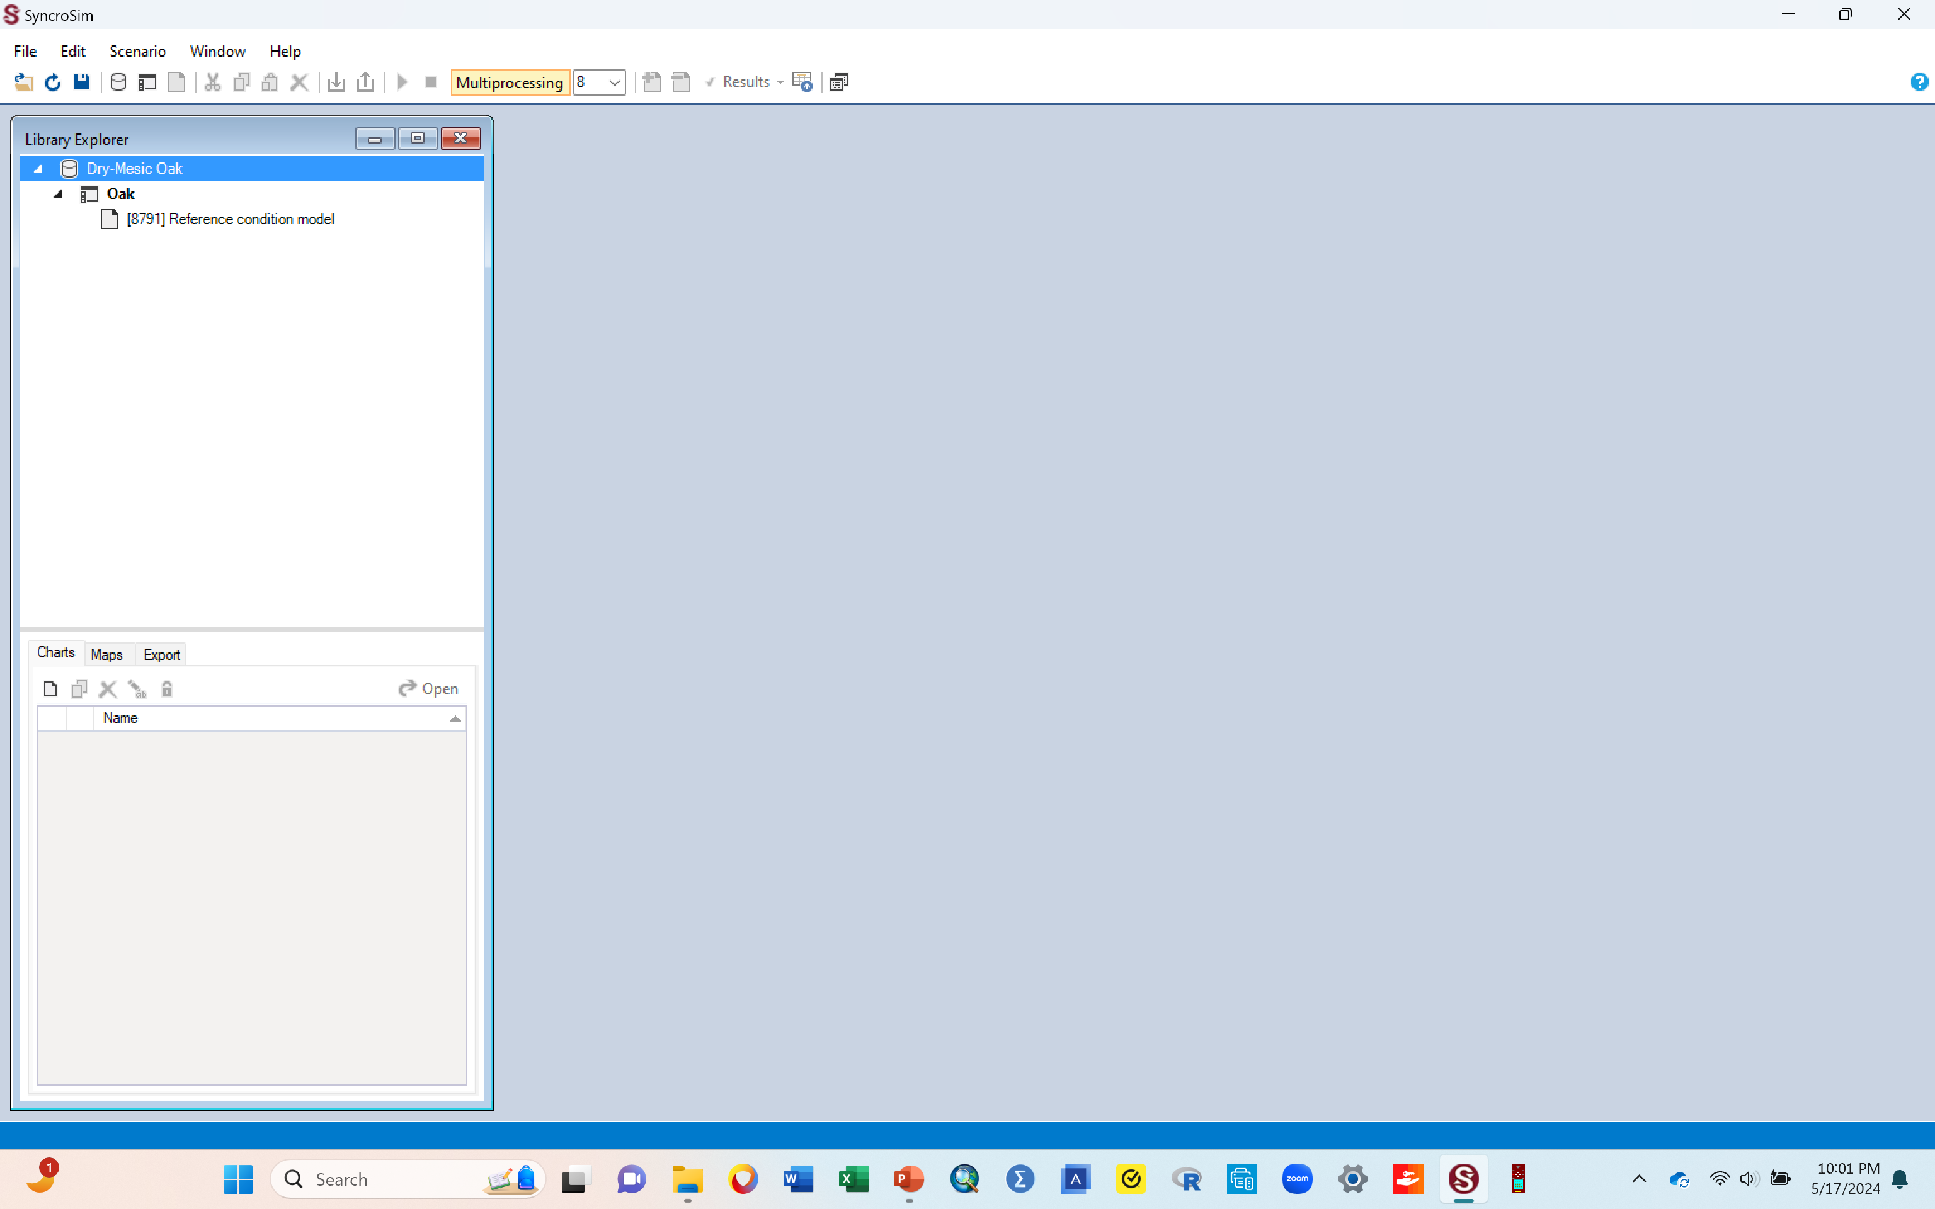
A. Bring into the workspace the library file that you are going to work on
To get started, go to File then select Open. You’ll have to navigate to where you have the “oak.ssim” library file to get it.
    If additional pop-up boxes come up asking you to convert or update the file you just called in, follow the instructions on the screen to click “apply” or “OK” to convert it to the latest version
  Sometimes, other libraries from previous work may show up on the library explorer pane to the left of the screen when you call in the oak library. If this happens, delete these other libraries by right clicking each and selecting “close” in the options that come up. This will ensure that the only library left on the library explorer pane is the one you just called in.
Once the file is called in correctly, the workspace should look similar to the one below. The file you just called in should show with the name “Dry-mesic Oak” (Second arrow in the figure below).
  If it shows up with a different name, you can right click it, select rename to rename it “Dry-mesic Oak”
Reminder: Once you start conducting the exercises of this activity in SyncroSim, get in the habit of frequently clicking the save button in the top panel (First arrow in the figure below) so you do not lose what you have done, incase something happens.
Go to the next slide

Slide 5
A. Understanding the library and workspace: an explanation, do not do anything
The oak.ssm file that you called into the workspace (the Dry-mesic Oak) is called a library file. A library is a file that stores all your model inputs and outputs (has the things that you will need to work on).
  Think of a library as the ecosystem that you want to work with, say a type of forest. In this case, the ecosystem is a Dry-mesic Oak forest.
  This ecosystem is a North-Central Interior Dry-Mesic Oak Forest and Woodland. A document with background information about this ecosystem is provided for you (Supplemental material 2a).

Slide 6
A. Understanding the library and workspace: an explanation, do not do anything
Once you start working on a given library, you can create various projects (from the library) and name them appropriately.
  In this example, a project called “Oak” has been created for you, named “oak” because we are working on an oak forest.
  Think of a project as the thing you are working on, say invasive species (this project could be named “invasives”), or fire (this project could be named “fire”).
  The work you are doing on invasive species is one project, the work on fire is another project, both of which can be done on the one library (your oak forest).
  If the project (Oak) shows up with a different name, you can rename it by right clicking it and selecting rename, then giving it the name “Oak”.
Once you have a project (e.g., oak), you can work on various scenarios within that project. Scenarios are like the various aspects of the issue that you are working on..
  For example, if your project is say fire, you can work on various scenarios of fire by changing the parameters of the fire during your modeling process. You could examine the impact of different fire severities, so that scenario 1 could be a fire that returns every 5 yrs, and scenario 2 could be a fire that returns every 10 yrs..
  In this example, the first scenario called “[8791]Reference condition model” has been made for you. This first one is the original scenario, and it stays in place throughout your modeling exercise (do not delete it).
  You can rename this scenario too

Slide 7
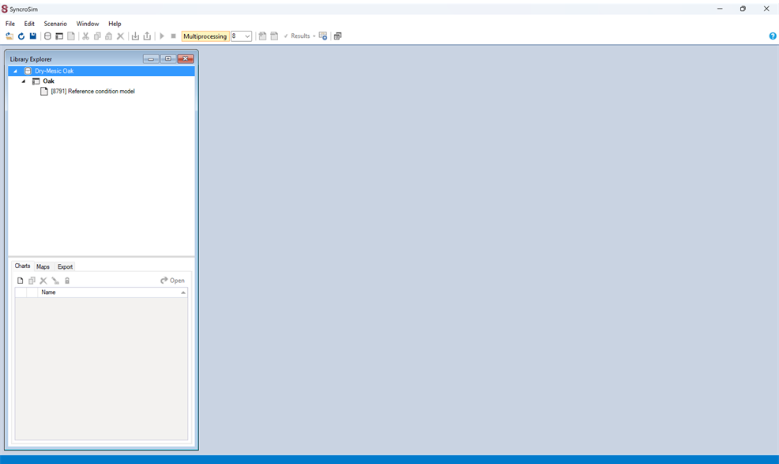
B. Delete unwanted items in your workspace, if there are any
Sometimes, your workspace (the screen below) can have other libraries, projects or scenarios and their results.
    This maybe be because someone had used SyncroSim on the computer and saved their output. When SyncroSim is opened again, all the previous saved items show up on the library explore window on the left in the figure below. You need to delete them in order to have a clean start.
    To delete these files, right click each of these extra items and select delete or close to remove them.
    For purposes of making the activity simple and straightforward, your workspace should only have the Dry-mesic Oak library, the Oak project and the “[8791]Reference condition models” scenario, as shown in the figure below.
If there are no other files in your workspace, you are good to go, just go to the next slide to continue.
Go to the next slide

Slide 8
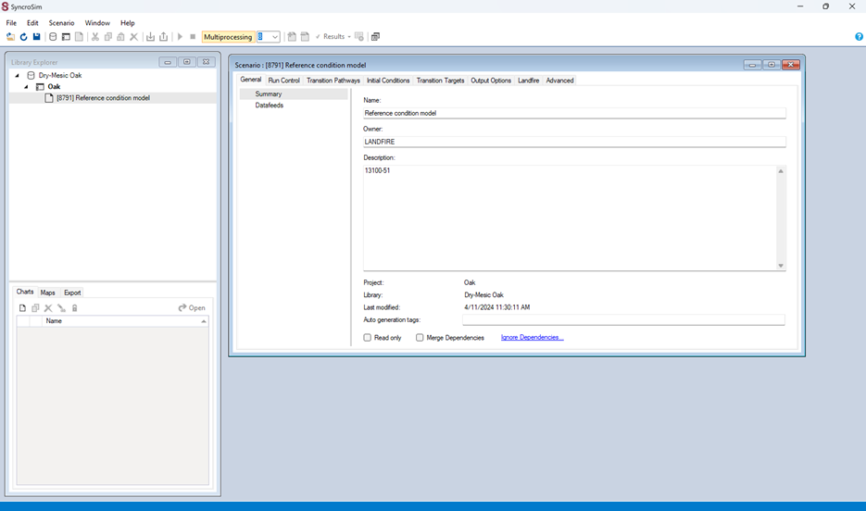
C. Bring up the scenario pane (the pane where you look at and create desired scenarios)
Remember, our original scenario was the “[8791]Reference condition models”
We now want to open and examine it. Its contents will be contained in a pane called the scenario pane.
Bring up the scenario pane by double clicking the reference model (double click the 8791 Reference condition models).
Once the pane is up, you will now have two panes open; the Library explorer pane (the vertical one to the left), and the scenario pane (the horizontal one to the right) in the figure below.
You can .
    move the scenario pane around to rearrange the two panes so they are next to each other, OR,
    click the “window” tab in the top panel and select “Arrange all”.
    You can also expand the scenario pane downwards (or sideways) manually, to help display all of the pane’s contents.
When done, your workspace should look similar to the one below, for option 1 above
Go to the next slide

Slide 9
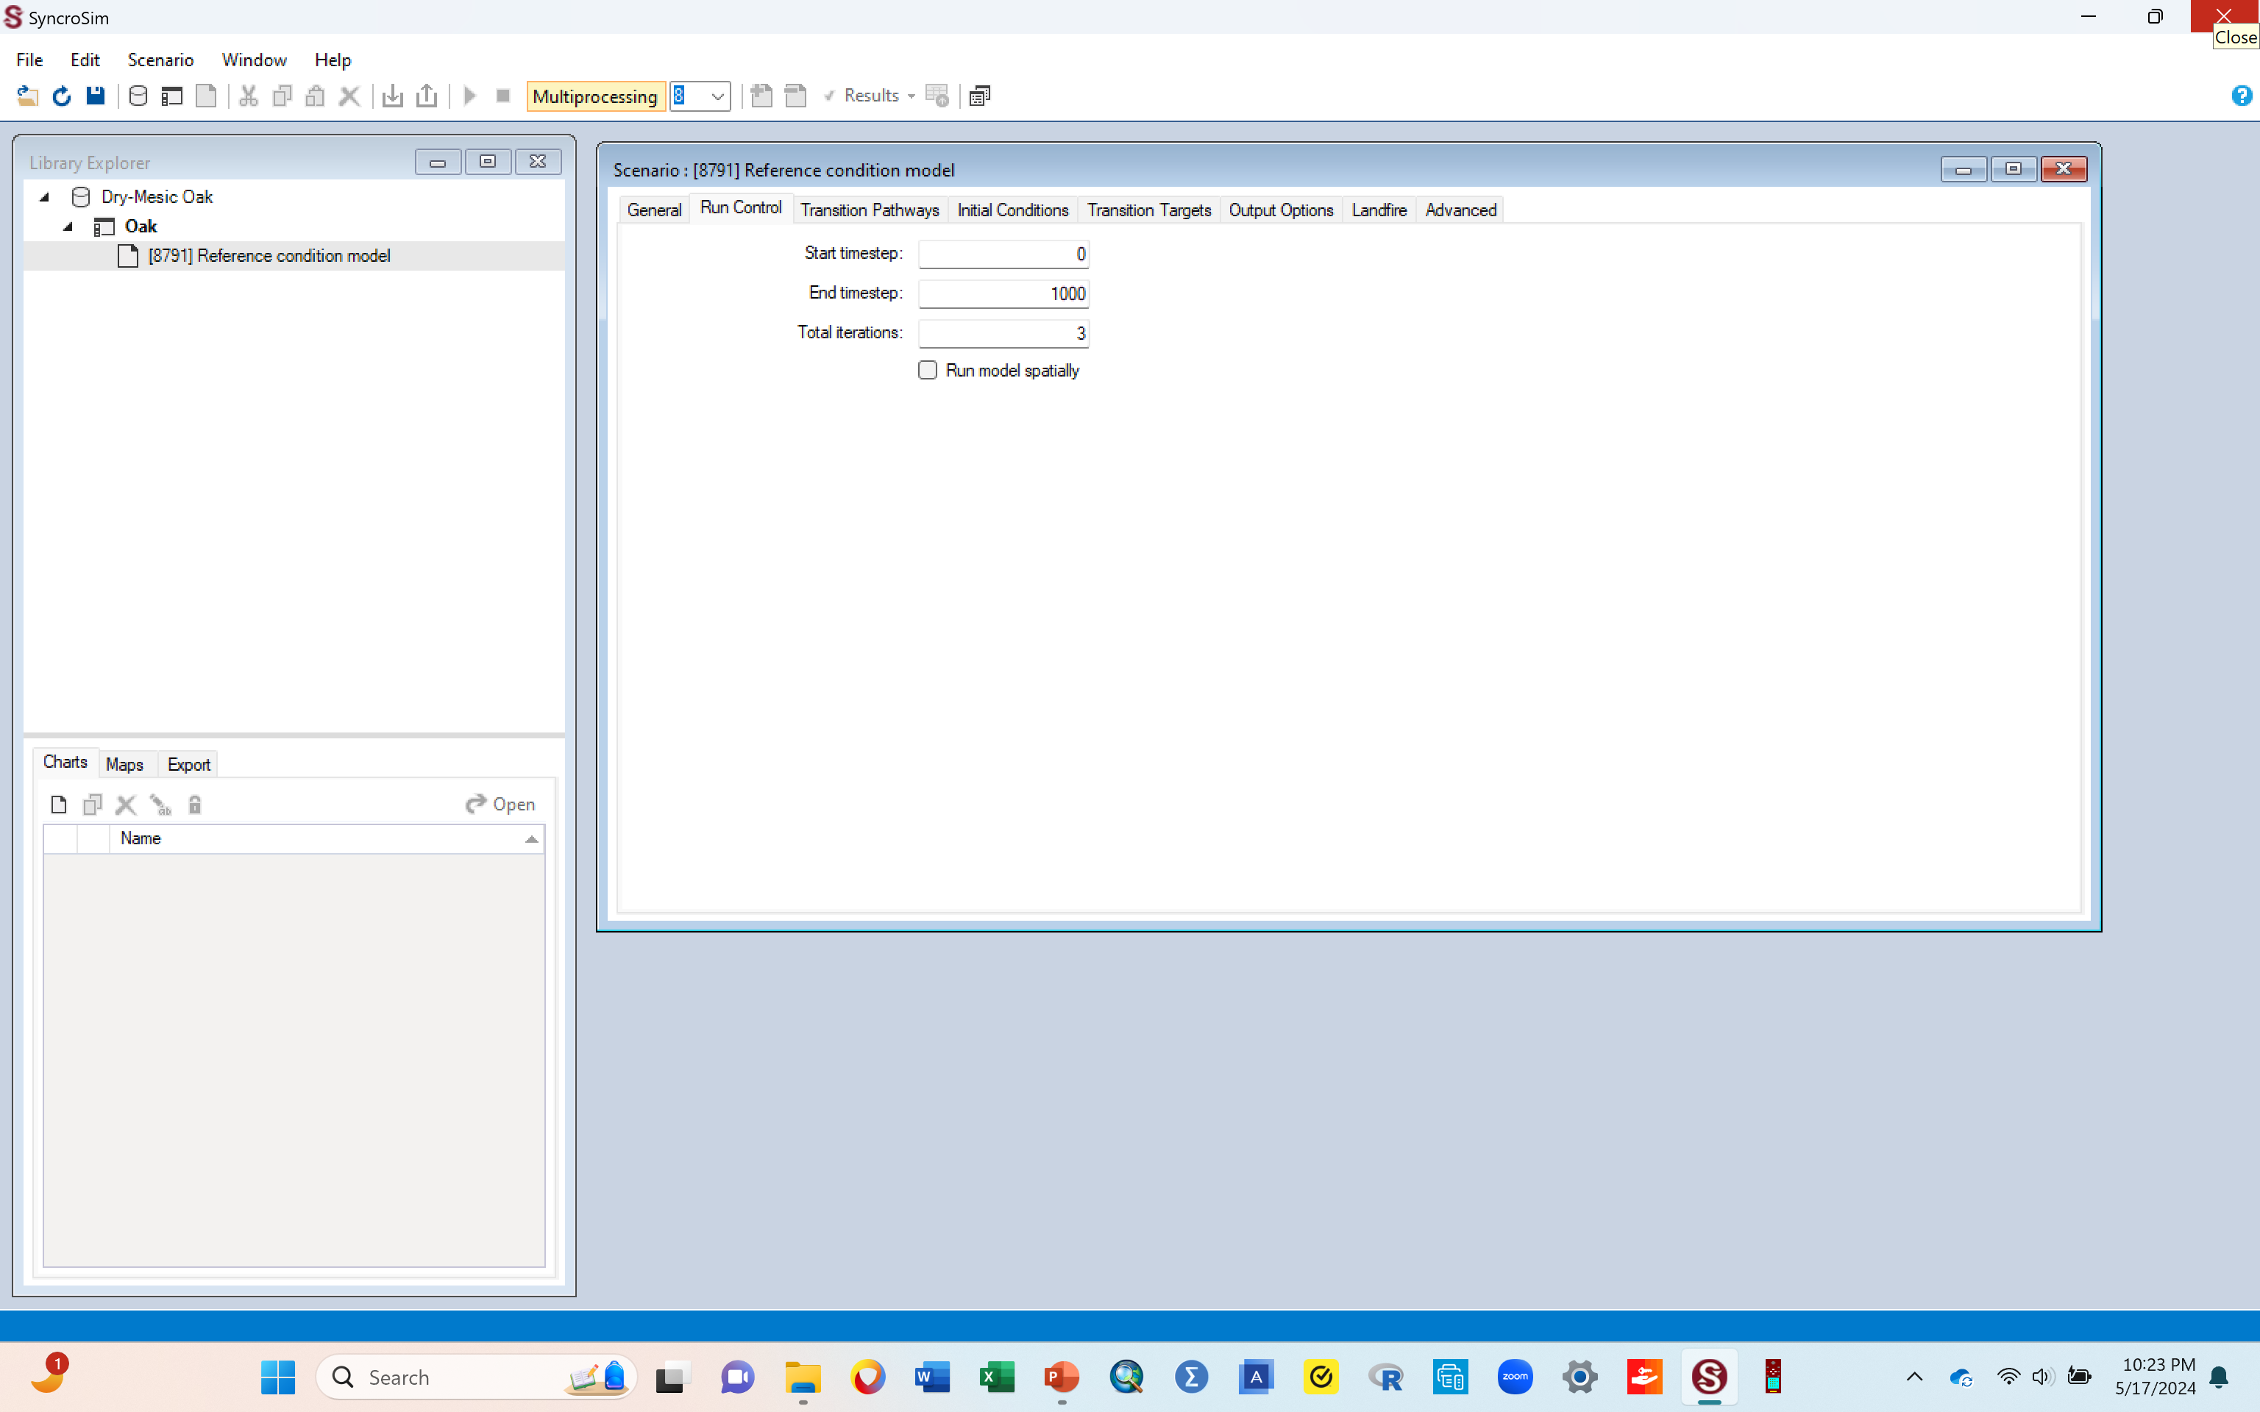
C. Bring up the scenario pane (the pane where you look at and create desired scenarios)
In the scenario pane, click the “Run control” tab at the top of the scenario pane.
  The “start timestep” line should have zero in the box.
  The “End timestep” line should have 1000 in the box. If it doesn’t, type in 1000 to replace what's there.
  The “Total Iterations line” line should have 3 in the box. If it doesn’t, type in 3 to replace what's there. We are telling it that whenever we run the model, we want it to do 3 iterations of the run. We selected 3 to save time since the more iterations you put, the slower the run is likely to be. You can enter more iterations if needed.
  The above terms are also explained in the glossary document provided in Glossary of terms (supplemental material 8)
  Click the save button. You must do this to save the changes you made, otherwise they will be lost.
  When done, your window should look similar to the one below.

Slide 10
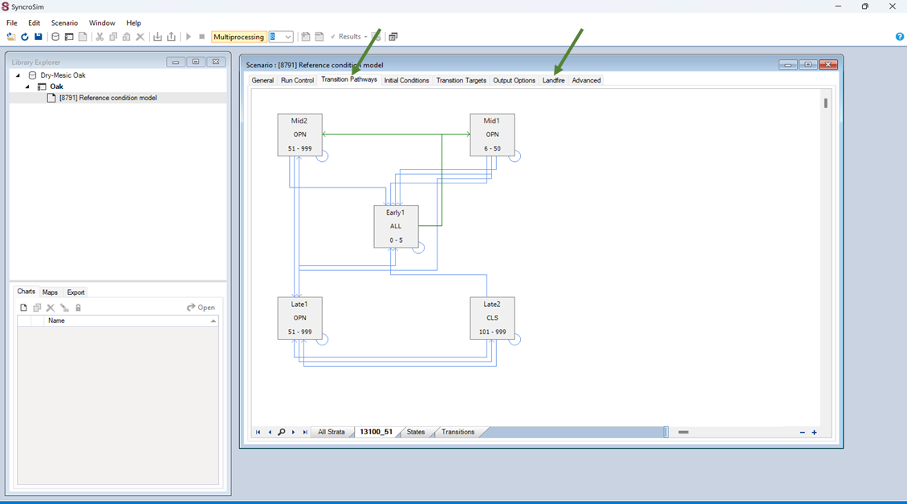
D. Display the normal succession classes for your ecosystem
We now want to see the different successional classes that exist in this ecosystem.
  The details of these classes can also be viewed by clicking the “landfire” tab at the top of the scenario pane (second arrow), and in the oak literature document (supplemental material 2a), where each of the classes are also explained.
To display the classes, click the “Transition Pathways” tab at the top of this pane (first arrow).
  The classes will be shown in boxes in the diagram, with lines connecting the boxes. Extend the bottom boundary of this pane downward so you can see all the classes in the diagram.
    The boxes are the successional stages, also called “state classes”, and the lines connecting them are the paths that they would take when moving from one successional stage to the other, also called “transitions”.
    In this original diagram, the classes shown are the succession classes that exist in this ecosystem under normal succession, i.e., with no external disturbances introduced yet
When done, your window should look like similar to the one below
Go to the next slide

Slide 11
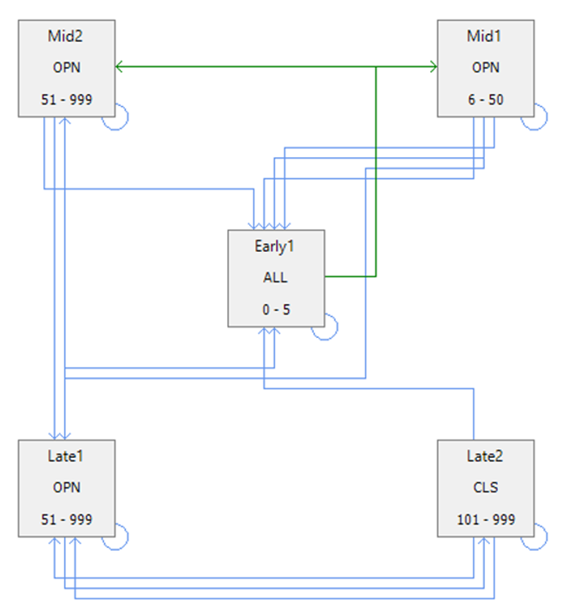
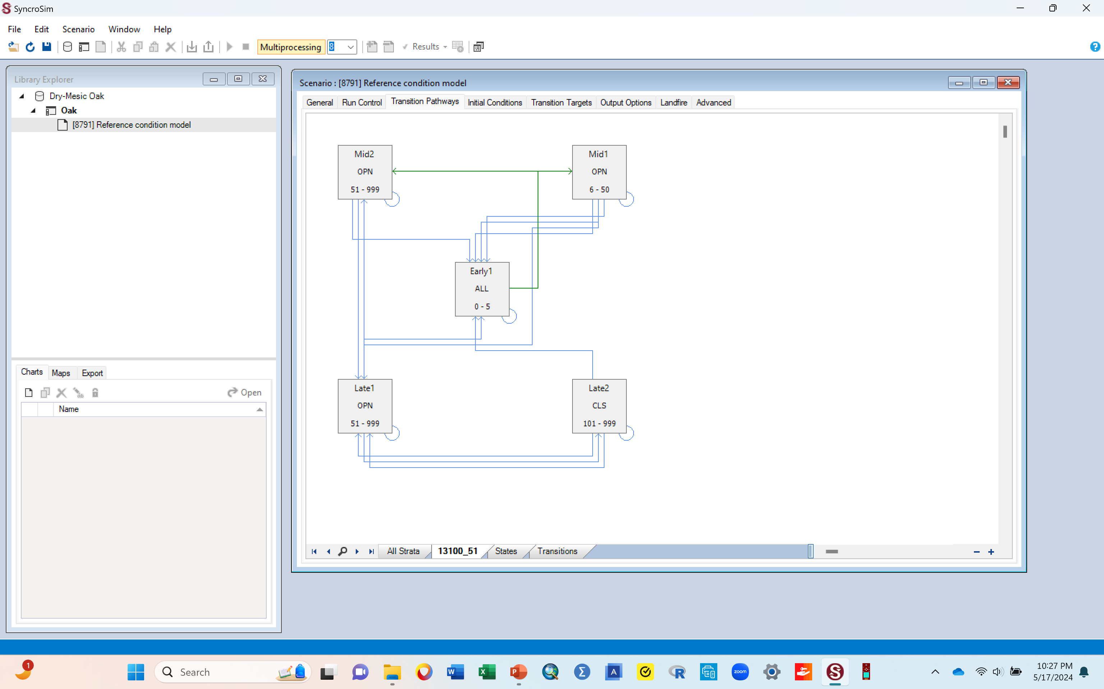
Assignment # 1:
Take a screen shot image of the transition pathways diagram, paste it to your word document, and caption it as “Figure 1. Normal succession”.
Once you paste it, it helps to crop it so that only the pathways diagram (the part inside the dotted box below) is left (similar to the diagram on the right). This makes it so that you do not submit an image that shows your whole screen.

Slide 12
E. Explanation: what the boxes in the diagram and links connecting them mean
In the pathway diagram:
Each box represents a succession stage in the system (also called State classes). The general succession classes (state classes) we know in ecology are Early succession, Mid succession, and Late succession. For this activity however, a gradient of these state classes (subdivisions) is given. For example, we have Mid 1 and Mid 2, representing 2 stages of the mid succession. In the pathway diagram you have here, both the Mid and Late state classes have two options each. The number and kinds of state classes will differ depending on the ecosystem (library) you are working with.
The green lines connecting these boxes are the normal succession pathways the system goes through from one stage to another, with no external disturbance.
The blue lines connecting these boxes are the succession pathways the system goes through from one stage to another when there is some intervening disturbance. If you introduce a disturbance to a system, it is the blue pathways that are affected and where movement happens.

Slide 13

E. Explanation: Understanding the state classes and the linkages
In the pathway diagram
Each box has text inside it that tells you the name of the successional stage (e.g., early 1), the nature of the canopy (ALL, OPN or CLS), and how many years it lasts in that state class before moving to the next state class (e.g., 0-5)
The ecosystem you are working with for this activity has 5 successional stages: Early 1 (ALL), Mid 1 (OPN), Mid 2 (OPN), Late 1 (OPN) and Late 2 (CLS)
  Early 1 means early succession stage, and in this case, we only have one stage of this in this ecosystem; some ecosystem might have early 1 and early 2, which are just 2 gradients of the early succession stage, with early 1 being more of the initial early succession stage than the early 2 which would be a more developed/mature early succession stage.
  The same logic applies to all the other stages. In this case, you have 2 mid succession stages (mid 1 and mid 2) and 2 late (late 1 and late 2)

Slide 14
E. Explanation: Understanding the state classes and the linkages
In the pathway diagram
The letters inside the box describe the structure of the canopy: Canopy is open (OPN), canopy is closed (CLS), or canopy has a mix of some open patches and some closed patches (ALL, meaning mixed structure).
The numbers inside the box gives the range of time in years the succession stage can remains in that stage before it moves to the next stage, under normal succession (i.e., with no intervening disturbance)
  For example: in this diagram, the stage Early 1 has ALL and 0-5. This means that this stage of early succession has a mixed structure canopy (ALL) and will typically last in this stage (early 1) for between 0 and 5 yrs, under normal conditions with no abnormal external disturbances (i.e., naturally).
  After those 5 yrs., it should be expected to transition into the next stage, Mid 1, which will have a relatively open canopy (OPN) and last in that stage between 6 and 50 yrs. etc.
A reminder that the details of each of these classes can be viewed using the “landfire” tab in the scenario pane, or by reading the oak literature document provided (supplemental material 2a).

Slide 15
F. Now, we want to run the model to produce a graph showing how much of the ecosystem is classified under the different successional stages (state classes) previously described.
While you still have the scenario pane open, click the “Run Control” tab at the top & ensure the numbers you entered in those boxes are still there (0, 1000 and 3).
Exit the scenario pane (the one that you have been looking at) by clicking the red X button at the top right corner of this window, also shown by an arrow in the image below.
Go to next slide to see how your window should look when done

Slide 16
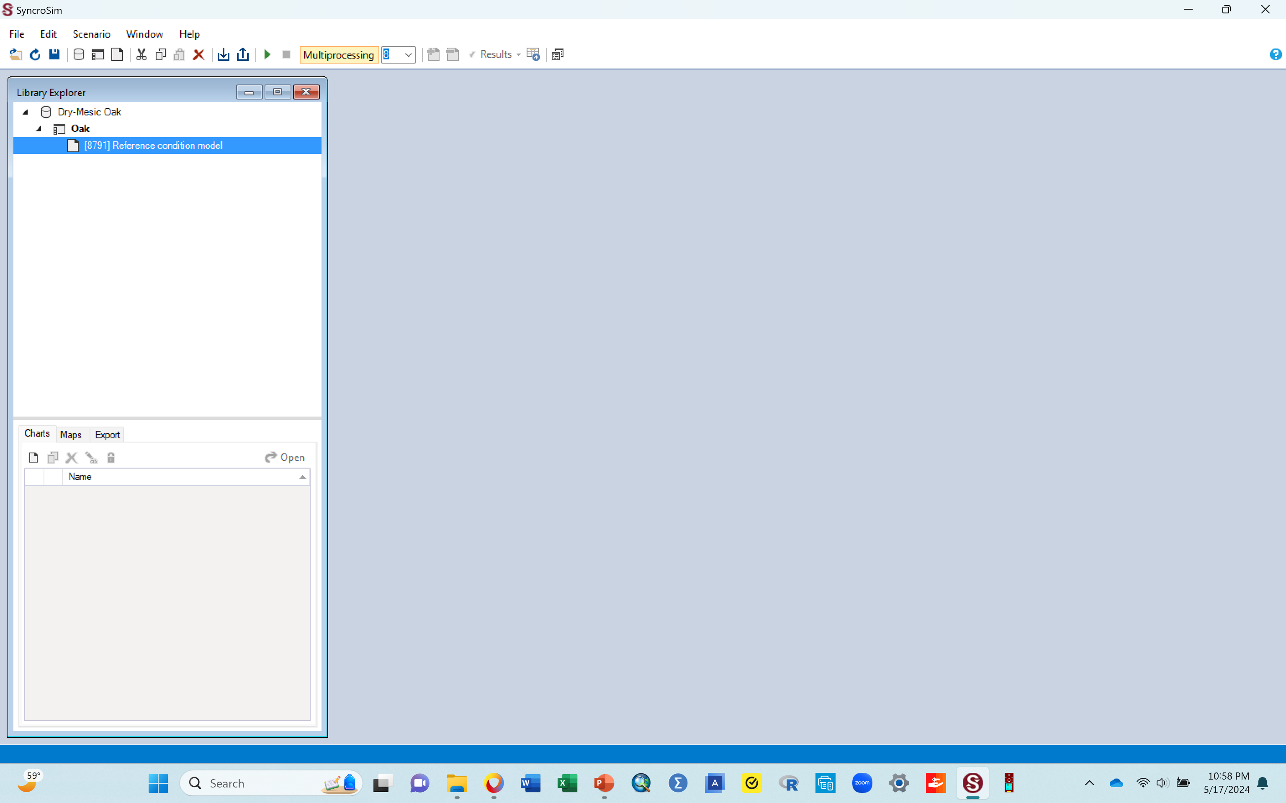
F. Now, we want to run the model to produce a graph showing how much of the ecosystem is classified under the different successional stages (state classes) previously described.
Your window should now look similar to the one below

Slide 17
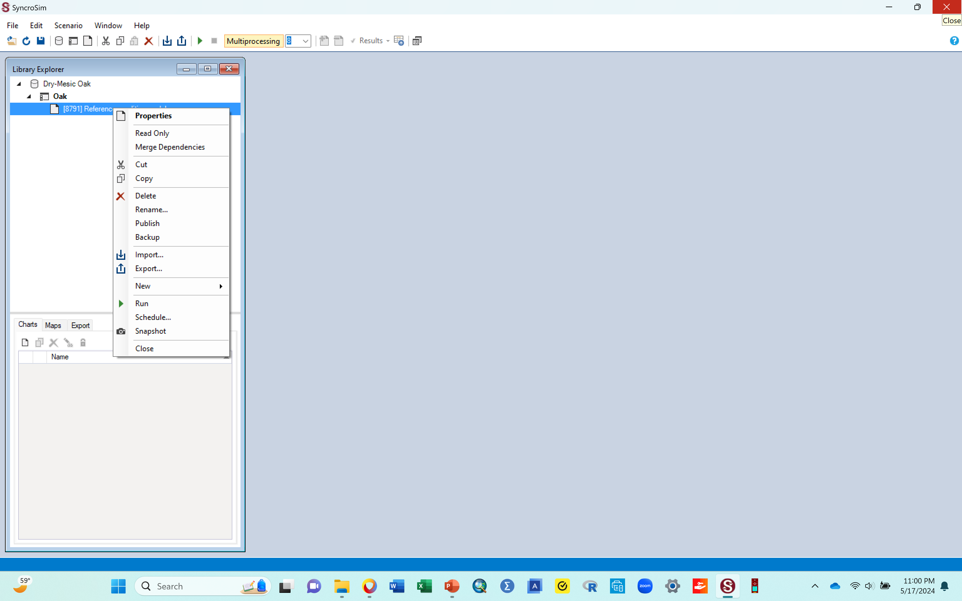
G. Run your model (for normal succession i.e., with no introduced disturbance)
We want to run the model for our original scenario (the Reference condition models) so we can produce a graph showing the proportions of the state classes i.e., how much of this ecosystem is made up of each of these classes
  To do that, click the Reference condition models scenario once to highlight it (it will have a blue color over it once highlighted).
  Then right click it, and in the resulting box, click the “run” tab that’s towards the bottom of that box (shown with the arrow in the figure below). The run tab is typically a green arrow that points to the right,
  Going forward, right clicking your scenario and them selecting this “run” arrow, is how you run a model for that scenario. This run tab is also on the top panel and can be clicked from there.
Once you click the run tab, a run monitor window will pop up to show progress and the run should complete in no time (since you asked it to do only 3 iterations of the run)..
Go to next slide to see what your window should look like when done

Slide 18
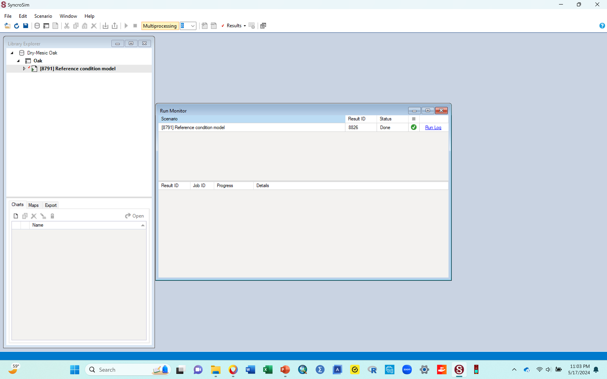
G. Run the model (for normal succession i.e., with no introduced disturbance)
When the run is done, your run monitor window should look similar to the one below.
  The blue text (says run log) and the box with a green check in it indicates that the model ran successfully with no errors during the run.
  Go to next slide

Slide 19
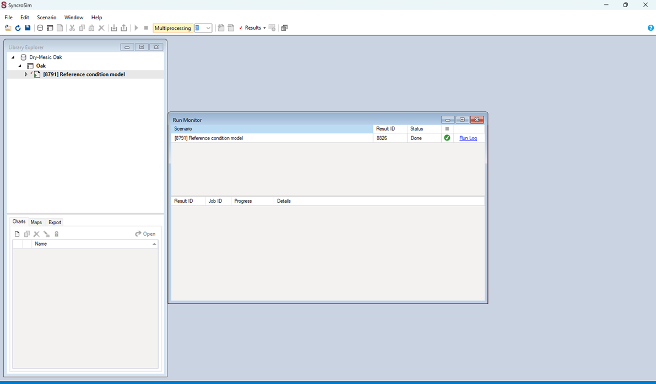
H. Exiting the run monitor window
You have just run a model of the original scenario, and all that is left is to display your results.
Before the display, you need to exit the run monitor window (the one to the right that showed that your run was successful).
To do that, click the red X to the top right corner of the run monitor window (shown by the arrow in the figure below)
Go to next slide

Slide 20
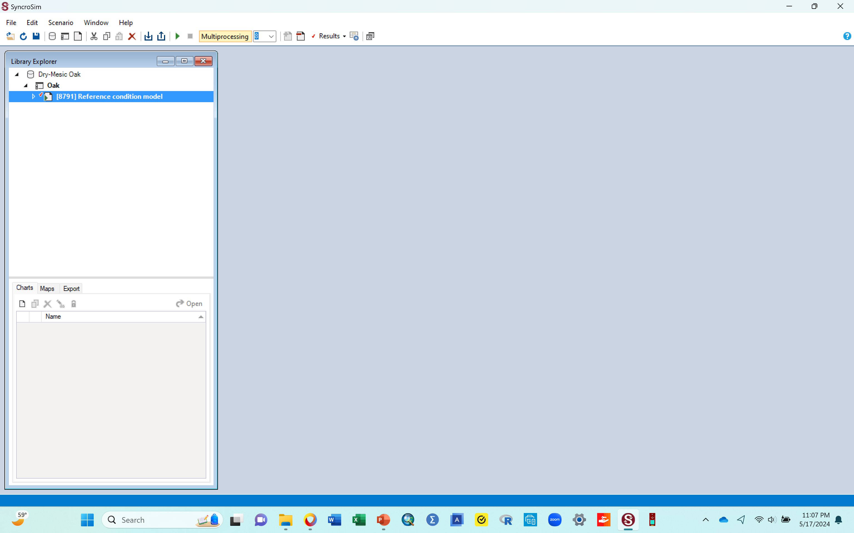
H. Exiting the run monitor window
Your workspace should now look similar to the one below
Notice that the original scenario (the Reference condition models) now has a little arrow pointing to it (shown by the arrow in the figure below). The presence of this arrow tells you that the model for this library has run and has generated results.
Go to the next slide to see the line of results that this arrow indicates

Slide 21
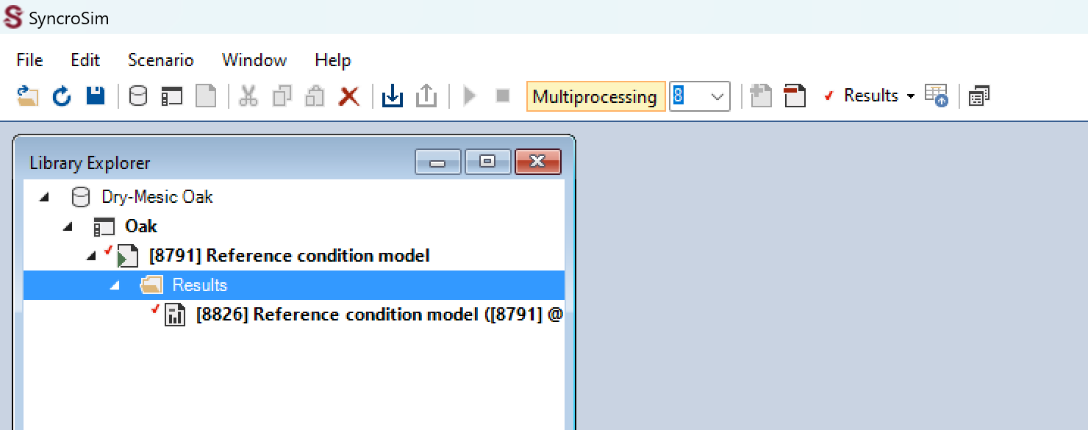
I. Viewing the result lines in the library explorer pane
If you click the little arrow pointing to the Reference condition model scenario, you will see “results” below it.
The results will also have an arrow pointing to it, and if you click that arrow, it will show a line of results
See below for what it looks like when you click these two sets of arrows
Note that to hide the results, you just need to click the two arrows again, the one pointing to the results, and the one pointing to the scenario

Slide 22
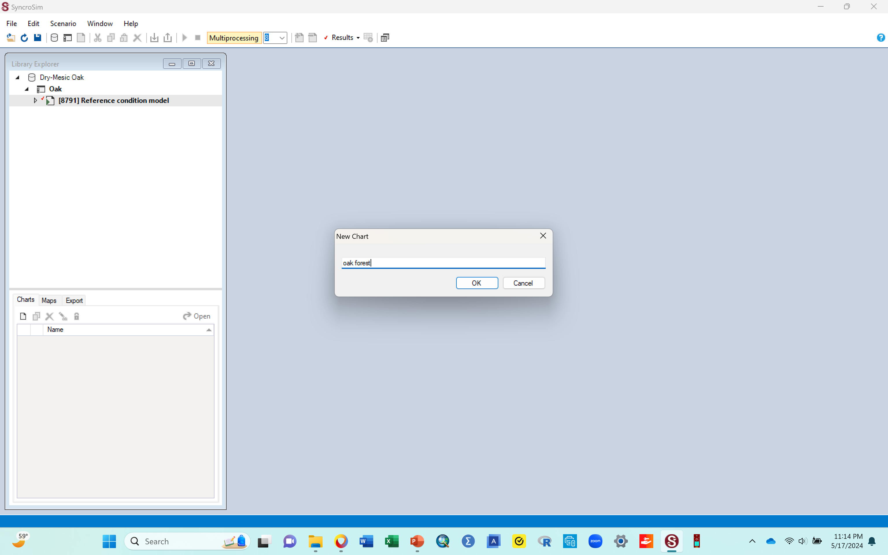
J. Next, you want to produce in a graph, the results of the model you just ran
Because you plan to make a graph, which in this activity is classified as a chart, you need to create a new chart and name it, as follows
  Click the “New Chart” tab (shown by the arrow in the figure below). A little chart box with a “chart1” written inside it will come up (the little box to the right in the image below)
  Rename the chart by replacing the “Chart1” with “oak forest” (just type that in there). You can also name this chart whatever name you want
  click Ok and a new window will come up.
  If everything ran correctly, go to next slide to see this new window
    Note: If using a personal computer, sometimes you might get an error message once you click ok as above. This is likely a computer specific glitch common with some personal computers, and in many instances, using a different computer can help. If you run into this problem, it is preferable to use a university computer where SyncroSim is likely to have been installed correctly, rather than a personal computer.

Slide 23
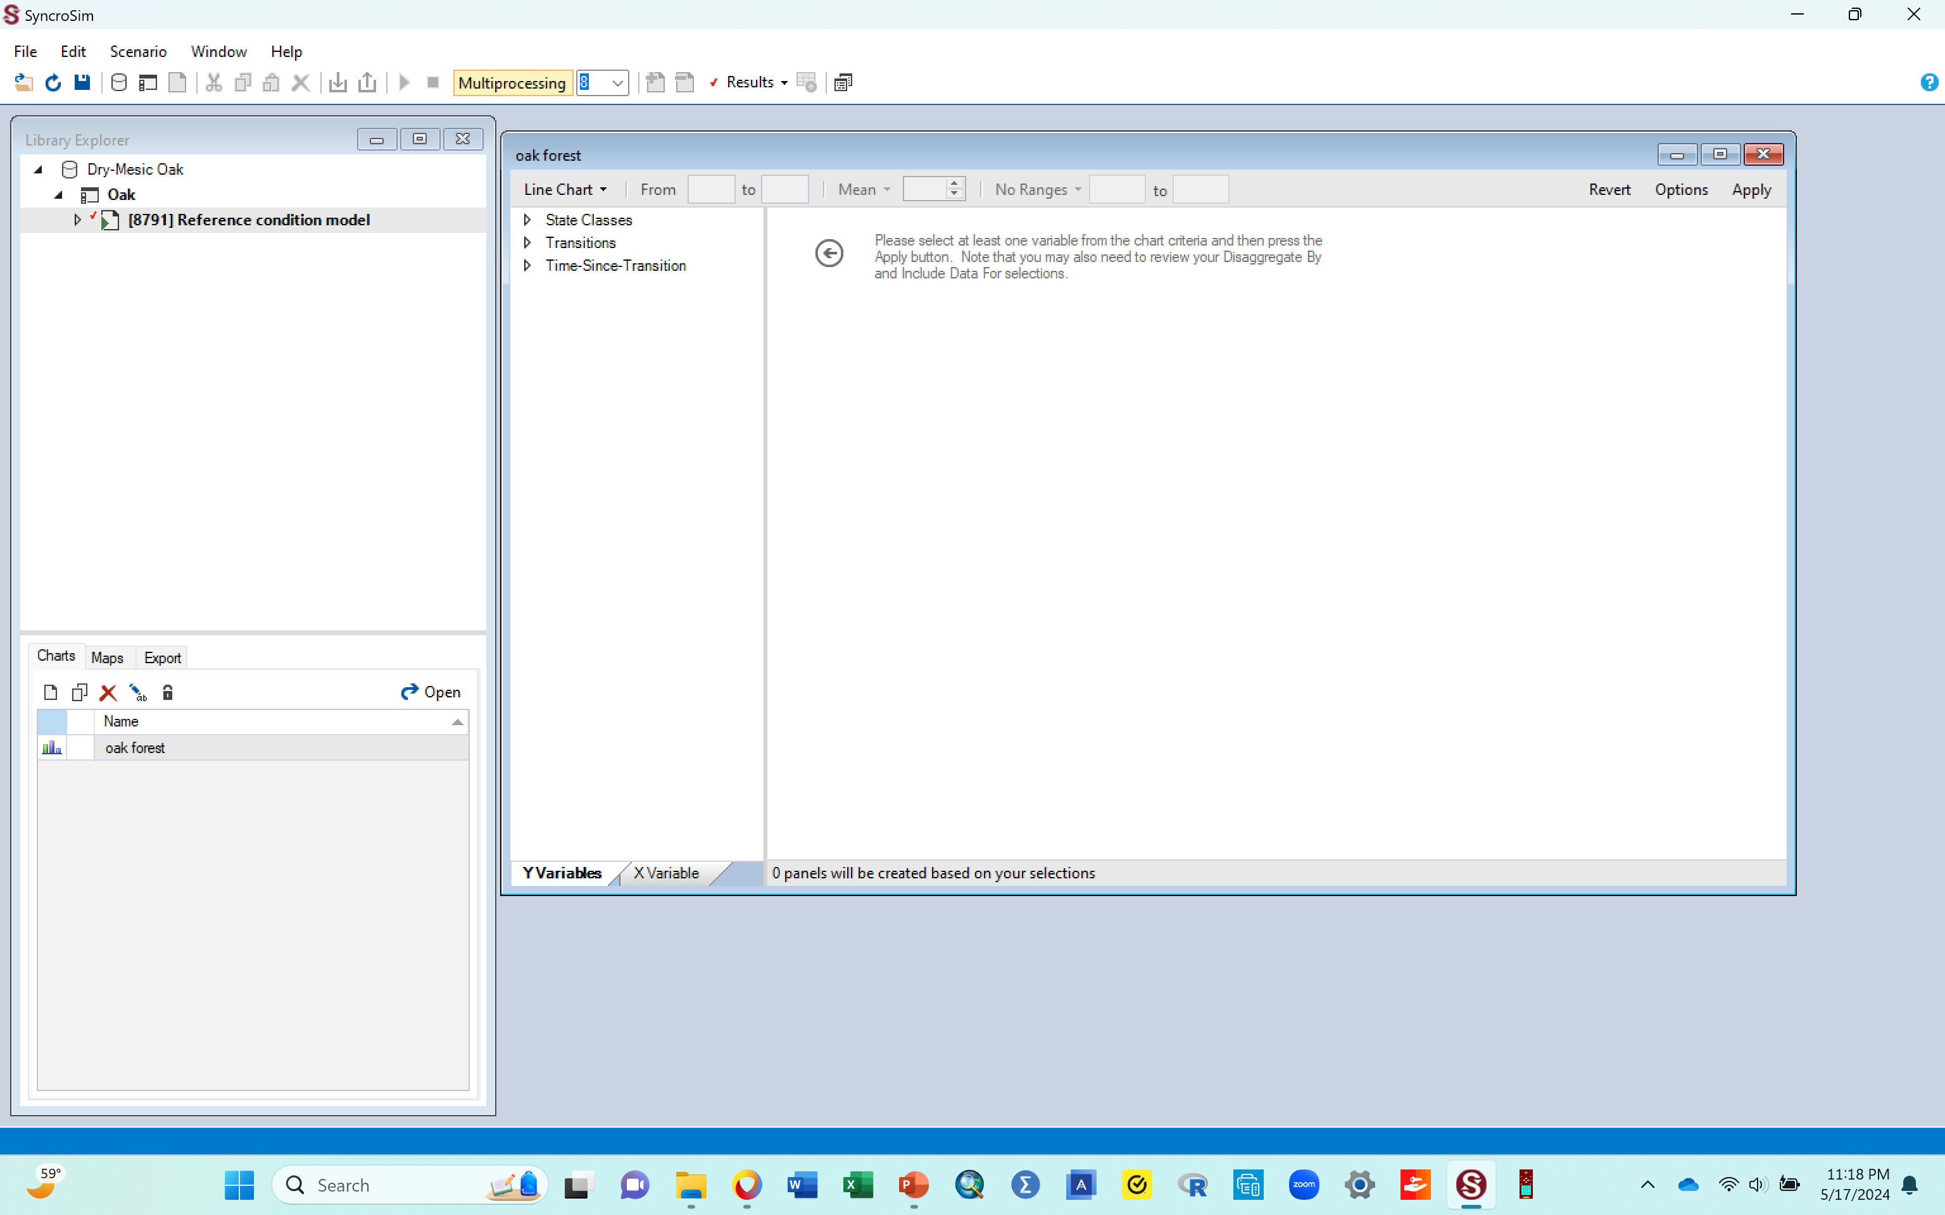
J. Next, you want to produce in a graph, the results of the model you just ran
The window below shows what should pop up after the previous step
  Note: When the new window pops up (the one to the right in the image below), it will likely be overlaying the library explorer pane that is to the left. For the two to appear side by side, just drag the new window to the open blue space to the right, so it's sitting next to the library explorer pane, similar to how it shows in the image below
When done arranging them go to the next slide to continue

Slide 24
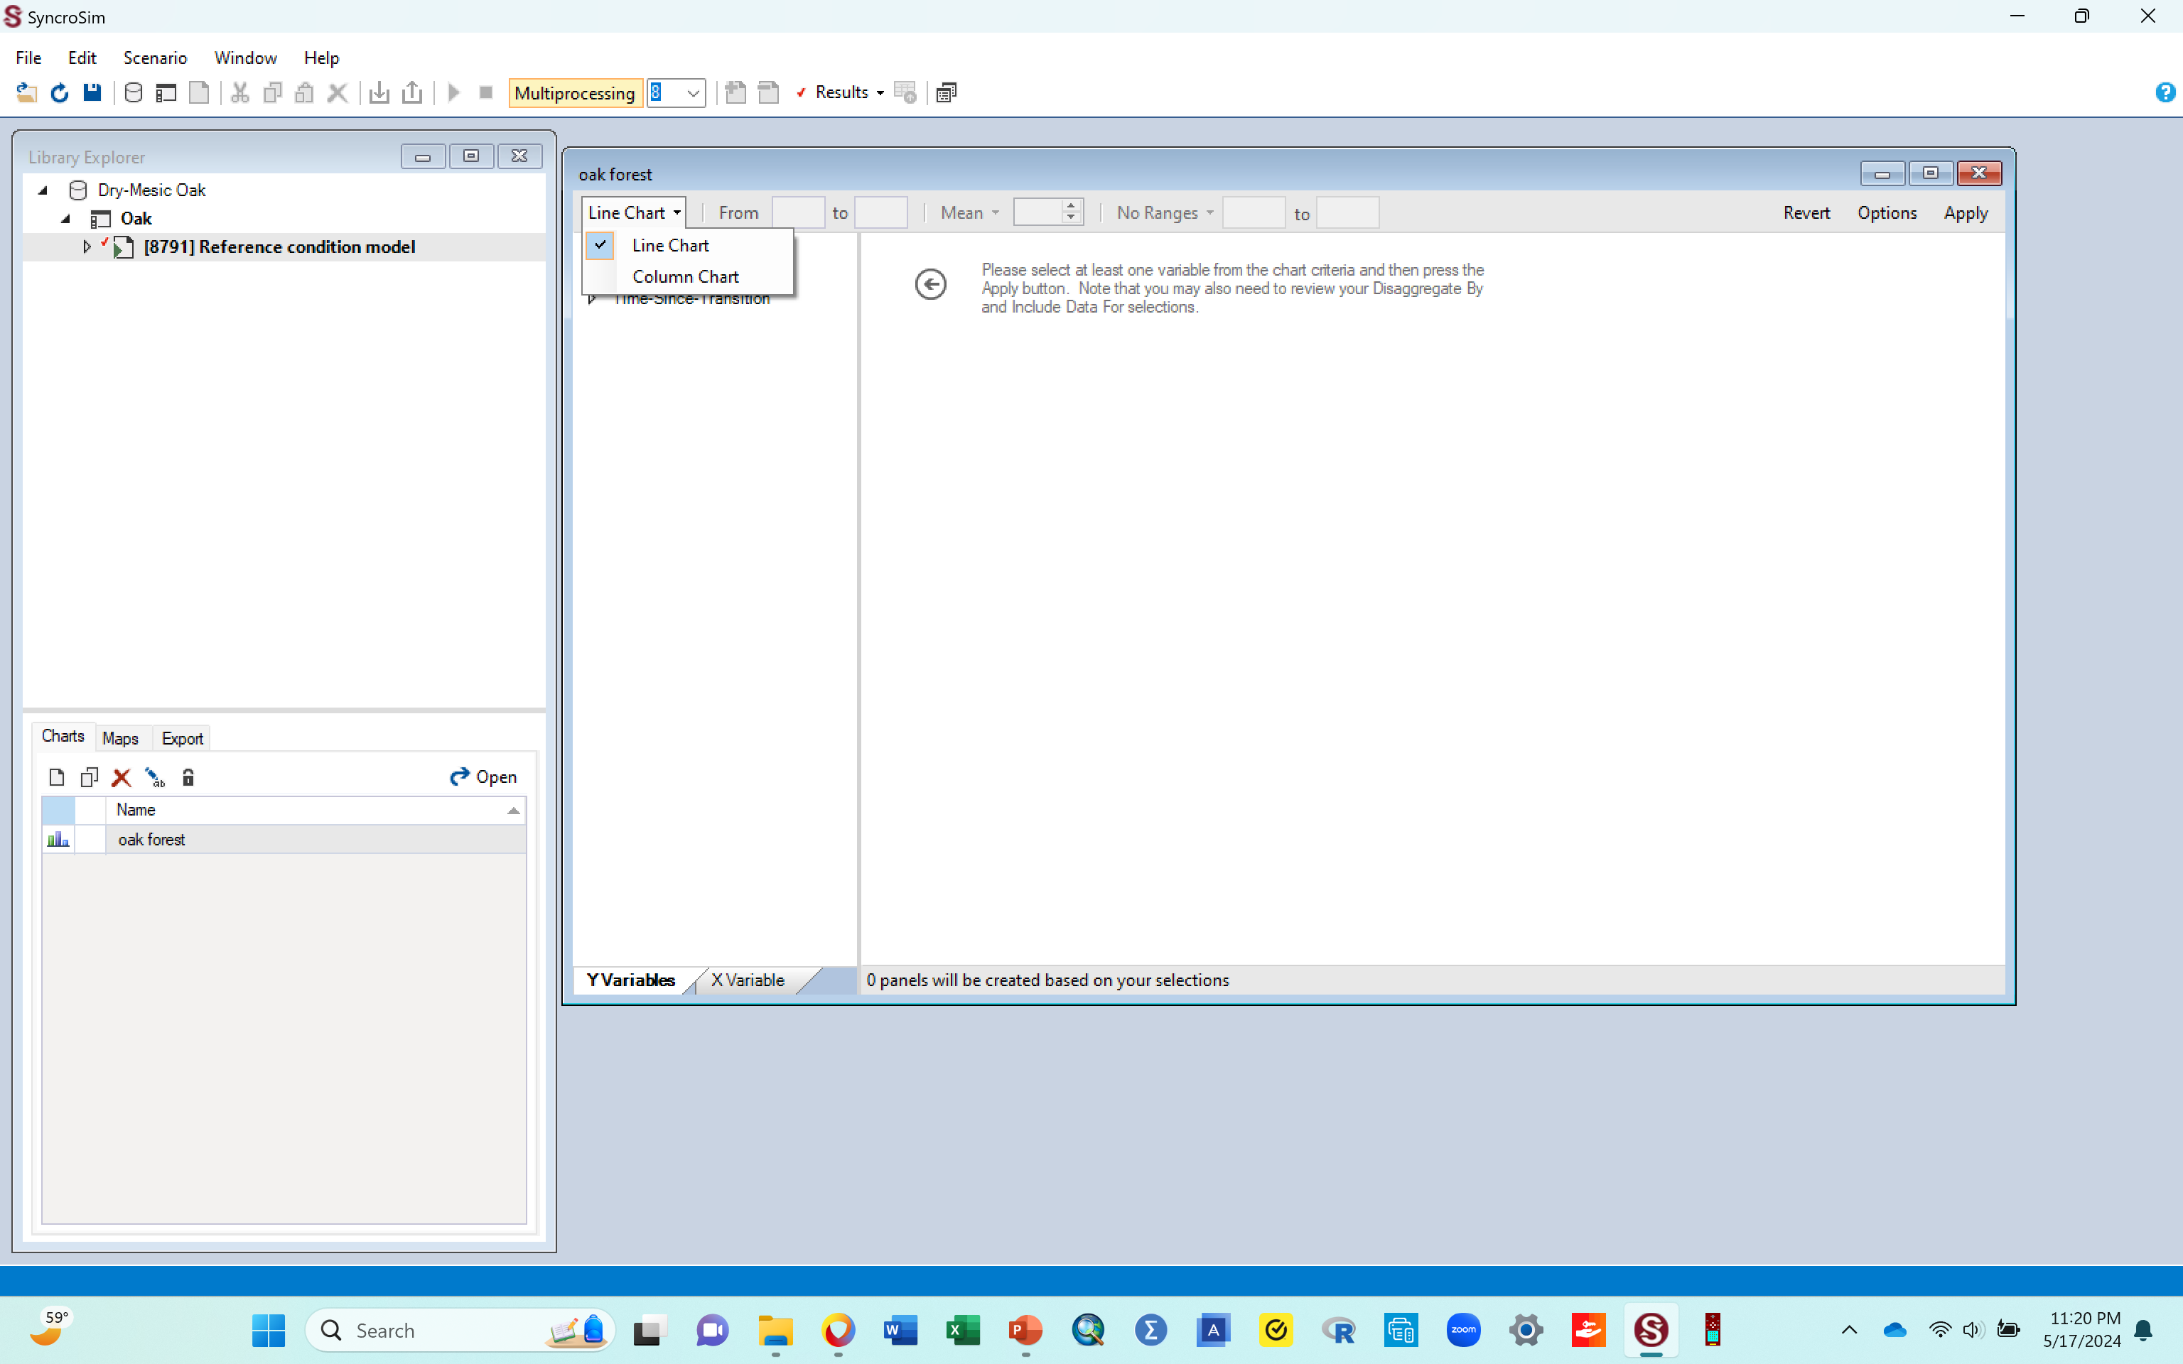
J. Next, you want to produce in a graph, the results of the model you just ran
Before you get a graph, you need to tell the graph a few more things that you would like it to show
First, you want to make sure the graph produced is a bar graph, not a line graph
  Click the dropdown under “line chart” and select “column chart” (area circled in the figure below).
      This ensures that you will have each succession stage presented as a bar graph, not as line.
      If you do not select the column option here, your graph will have lines instead and you don’t want that, for this activity.
When done with that, go to the next slide to see how the screen should look

Slide 25

J. Next, you want to produce in a graph, the results of the model you just ran
Your screen should now look similar to the one below
  You now have 3 tabs (shown in the circled area below): State classes, Transitions, and time since transitions.
  Each has a dropdown/pointed arrow before it
Next, you are going to make selections using the dropdowns/arrows for each of the 3 tabs
Go to next slide to do that

Slide 26
J. Next, you want to produce in a graph, the results of the model you just ran
Your selections will go as follows
Under state classes: select “proportion”
Under disaggregate by: select “state class”. While here, ensure that all the other boxes listed there are unchecked i.e., are empty with no check mark.
Under include data for: click “ state Class” , which brings up all state classes, and all of them have check marks.
You want to uncheck all of them, so you can manually check the classes that are represented in the the ecosystem you are working with i.e., the ones you had in your transition pathways diagram. The classes are also given below.
To do that:
  Click the very first box that says All. This will uncheck all classes
  Then manually check the boxes for these classes
      Early1: ALL
      Mid1: OPN
      Mid2: OPN
      Late1: OPN
      Later2: CLS
Note: Double check your check marks to ensure they are in the correct classes. Selecting the correct classes is critical for what you will get
When done, go to next slide to see what your screen should look like

Slide 27
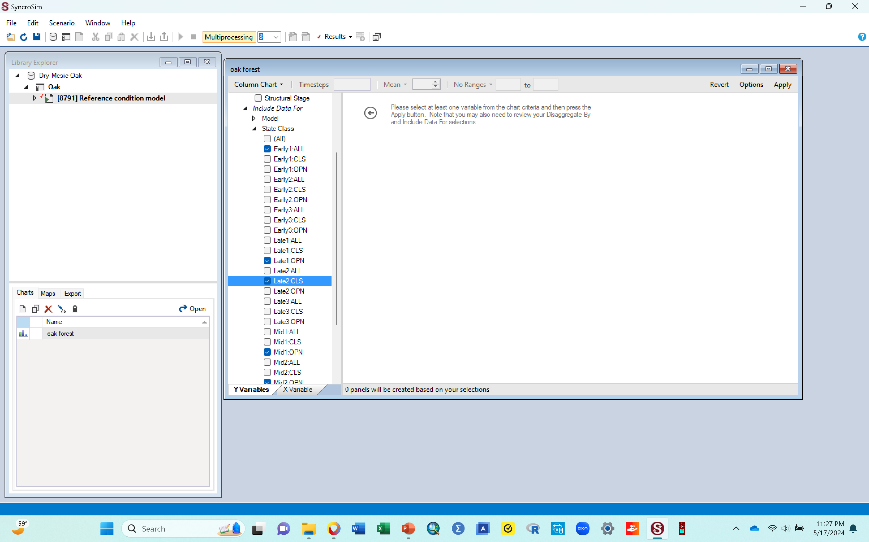
J. Next, you want to produce in a graph, the results of the model you just ran
You resulting screen should look similar to the image below.
  Some of the classes might be cut out in this image just because only so much could be fitted in.
Go to next slide to continue with your steps

Slide 28
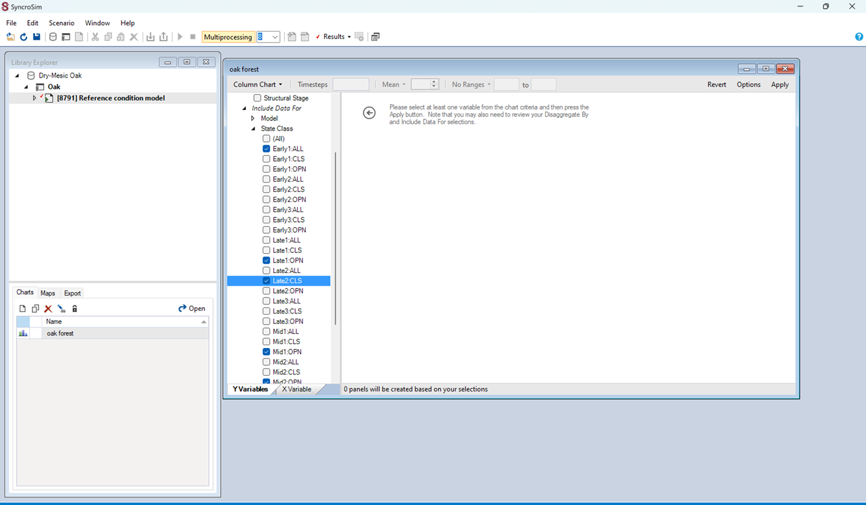
J. Next, you want to produce in a graph, the results of the model you just ran
Once you have checked the required classes, click the “apply” tab that is at the top right corner of the window you are working in (shown by arrow in the figure below). This step is what will produce a graph, so do not be surprised if one pops up soon as you click this tab!
You will get a bar graph!!
  The graph may pop up on the screen by default, OR
  You may have to double click the “oak forest” chart that you made in the chart area.
  Whichever works to display the graph
Go to next slide to see what such a graph should look like

Slide 29
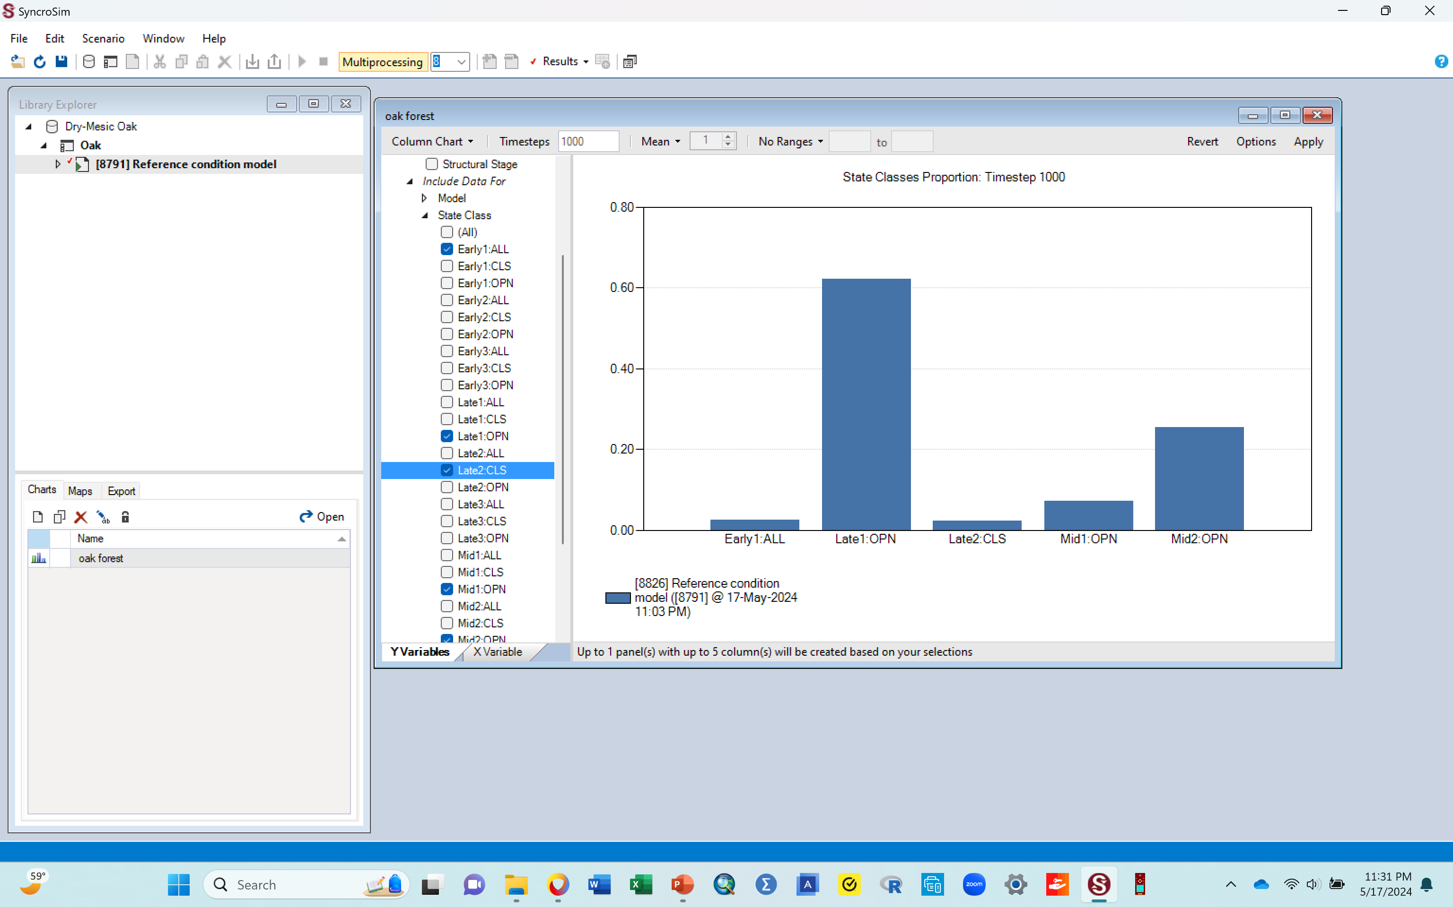
K. A bar graph, Yaay!!
The bars in the graph above represent the proportion (in %) of this ecosystem, that can be categorized under each of the 5 successions stages (state classes). That means that if say you walked into this normal functioning healthy forest, there will be parts of the vegetation in it (a certain %) that can be classified as Early 1 All, another as Mid 1 Open, etc.
This is what this particular modeling activity is used to show; how much of your ecosystem falls under each of the succession stages under normal successional processes or when the system has experienced some kind of disturbance.
Later, you will see how a disturbance can change the proportions of these successional stages (changing the heights of each bar)

Slide 30
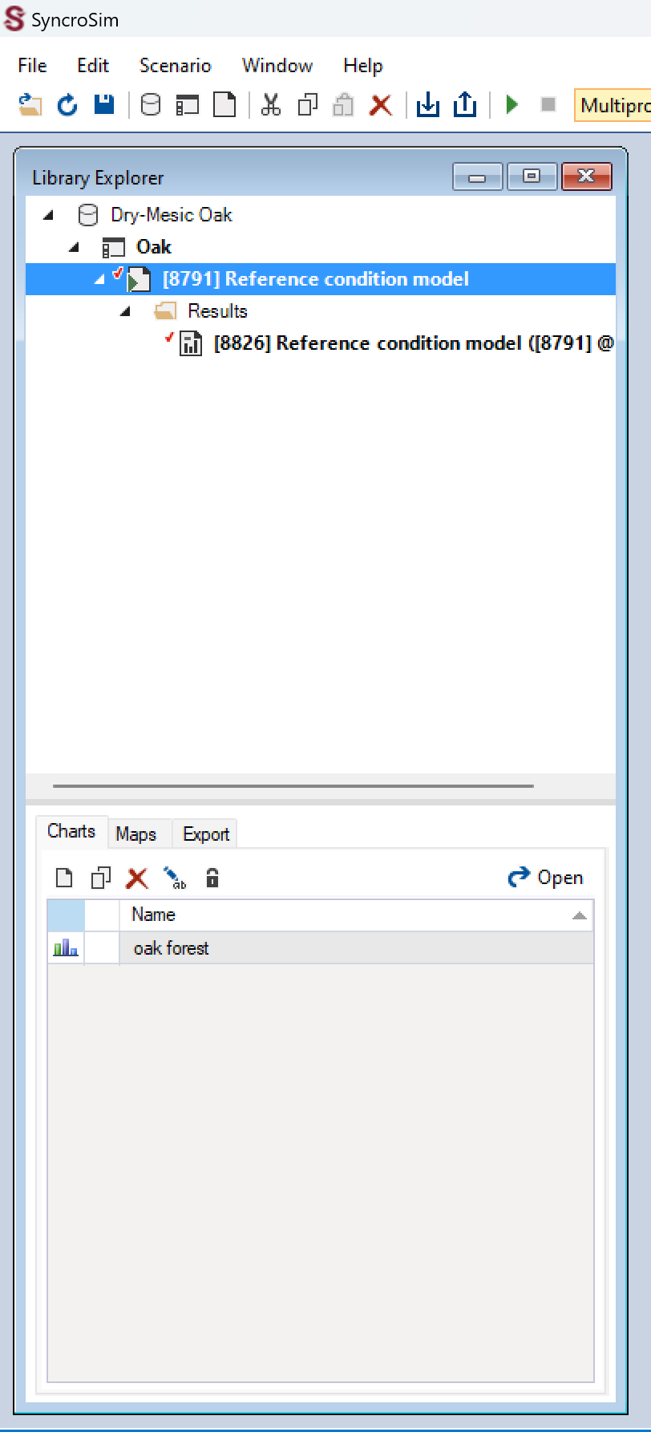
K. A few things to check regarding your graph and the workspace
Note:
  This first graph should have one bar for each of your successional stages(5 bars total, one for each class)
  If for some reason, you end up with more than one bar for each class, do the following to correct it
    Look at the library explorer section where you have the original scenario (the Reference condition model) (area circled here).
    Click the dropdown arrow next to the Reference condition model scenario. That will bring up “results” under it
    Click the dropdown arrow next to the “results” and that will bring up the result lines for all the scenarios/results showing up on your graph
    If you have more than one line of results there, starting with the top one and going down, right click each and select delete, leaving only the last one, which should be the most recent output
    You should just have one line of result under the “results” as seen in the image here. This ensures that you will have one bar graph per class. At this point, that is what we need.

Slide 31
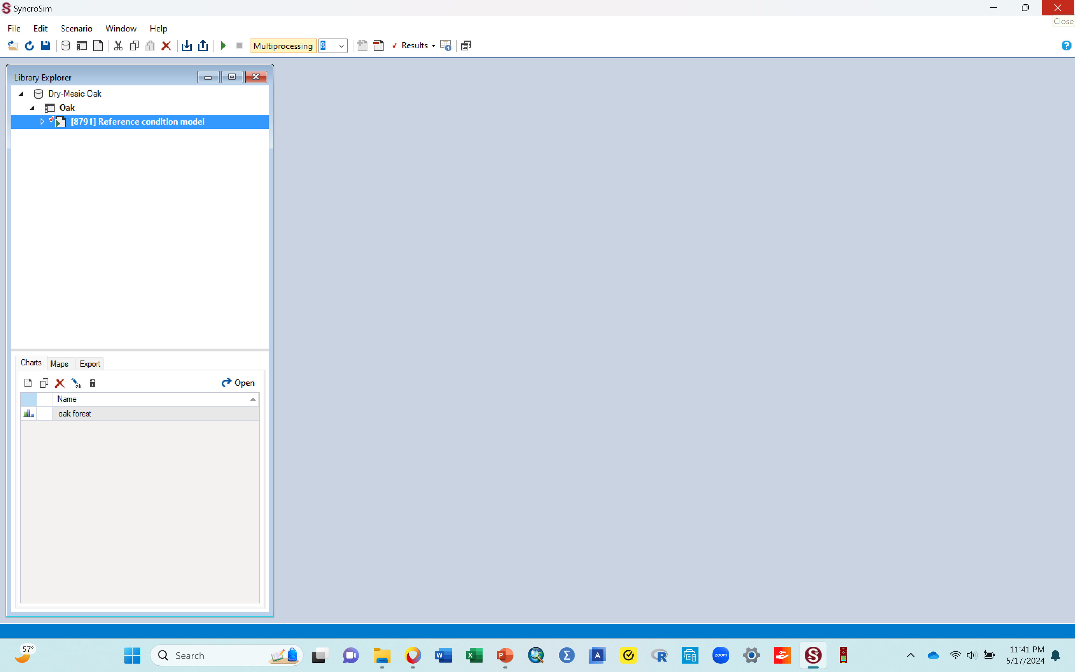
Copy your bar graph to your word document
Assignment # 2: Put cursor in middle of the graph, right click, select copy to clipboard, then paste in your word document. Caption it as Figure 2. Oak forest normal. Be sure you crop the image if necessary
Once you have copied the graph to your word document, you are done with the graph in your modeling window and can delete it so you can clear that window for modeling your next scenario.
To delete the bar graph, click the red X tab that is at the top right corner in the pane, just as you have done before
You screen should look similar to the one below when you are done with the graph

Slide 32
Part 2: Introducing an external disturbance to your ecosystem and modeling its impact on the succession stages (state classes)

Slide 33
L. Next, we want to introduce an external disturbance and model its effects on the succession of this system
You see, many of our ecosystems are not natural (healthy) anymore, because sooner or later, there is bound to be some external (and often unnatural) disturbance that impacts them.
So, while we would love for things to remain as they are (stay with the graph we just made, assuming that the system is healthy), that is not reality.
This means that in ecology, we always need to stay ahead of the problem, by modeling effects of such disturbances on an ecosystem before they happen, so we can forecast what the disturbance is likely to do to the ecosystem.
For example, if say the bar for the early 1 succession class in the graph you just made says the forest right now has 2% area classified as early succession 1, we want to introduce a hypothetical disturbance (like an insect invasion) into this forest, and we want to see if after running that disturbance scenario, the early one succession class will still be 2% or if the proportion of that successional stage will be reduced or increased.
If asked to do create and run a scenario with a disturbance impacting your ecosystem, the steps given below are how to do it.

Slide 34
L. Some explanations to help set the stage for this next part, do not do anything yet
So far, you have been working with one scenario (the Reference condition models). This scenario is the original/baseline scenario.
We used the word “normal” with this scenario because this is what the forest looks like currently, before it experiences any external disturbances. This is your baseline for comparisons later.
When you start this modeling activity for the first time (when you start SyncroSim and call in the library), you need to first run this original scenario (do all the steps you have been doing so far), so you can have the original bars (the blue one in the graph you just made). If you do not do this part (run the original model), then when you introduce a disturbance and generate bar graphs for that, it will give you bars for the new disturbance, but nothing to compare them to.
In the following section, we will be introducing a disturbance to this ecosystem (creating a new scenario).
You will need to run that scenario too and produce a new graph
That new graph will have 2 bars per state class. One bar will be for the original scenario (the one you just ran for the original scenario, its typically blue), and a second bar for the introduced disturbance (the new scenario, its typically red)
The new bars in those graphs (the red ones) will be representing the impact of that disturbance. As such, to examine any change that a disturbance causes, we will be comparing the height of the bars for the introduced disturbance (the red ones) to the height of the bars for the original scenario (the blue ones you just made). Both bars will be in the new graph.
Again, if you do not run the original scenario the first time, but instead go straight to running your disturbance scenario, you will not have bars for the original scenario to compare your disturbance ones to.
However, after running the original the first time like you just did, you can just keep creating and running your new disturbance scenarios without having to re-run the original scenario, because SyncroSim remembers that you already ran the original, and it will always show the original bars along with your new disturbance bars.

Slide 35
M. First, to introduce a new disturbance, you need to create a new scenario from the original one, that you can then apply this disturbance to.
  Some explanation first:
    Remember that the Reference condition model was your original scenario
    Creating a new scenario basically means you make a copy of this original scenario by copying it and pasting onto the project (oak).
    Making a copy of the original scenario scenario will produce a new scenario under it.
    Then you will need to give your newly created scenario a name.
    Then you will work with this new scenario to produce a new bar graph of results.
    Once you create a new scenario, and once you are done running and producing a graph with it, and copied the graph to your word document, before embarking on another disturbance (you can do several), you need to delete this scenario, so you do not have so many scenarios accumulated in your workspace, which can be confusing for a student that is just getting started with this kind of an activity.
    The only scenario that stays in place always is the original one (Reference condition models). Any new one you make needs to be deleted after you are done with them.
    Now go to the next slide to start the steps of creating a new scenario and introducing a disturbance to it

Slide 36
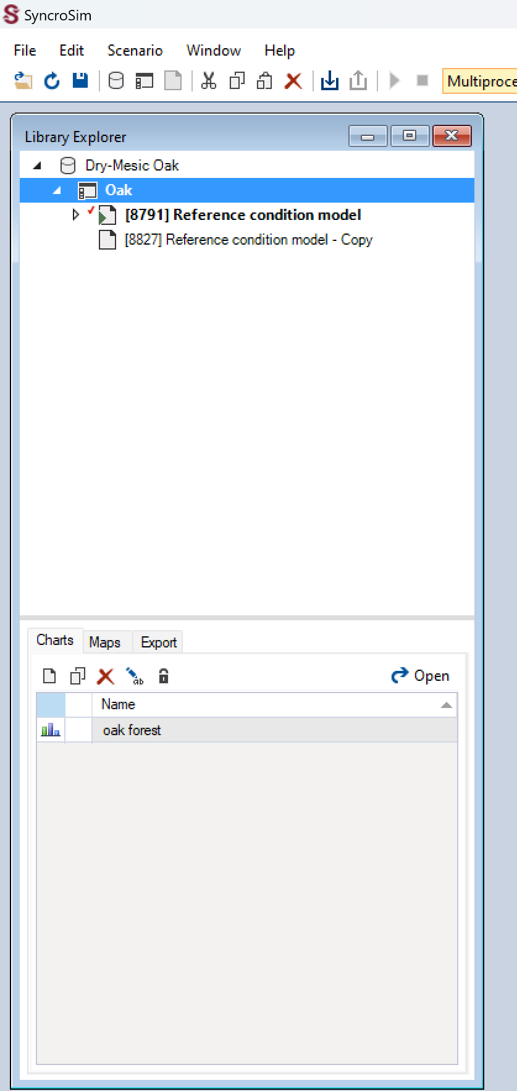
N. Create a new scenario with a new disturbance
Follow the steps below to create a new scenario for the new disturbance
Note: we always create a new scenario by copying the original scenario (in this case the Reference condition model) and pasting it into the project that you are working with (oak in this case).
Right click the “8791Reference condition model” scenario, select Copy
Right click on the project (“oak”) and click “paste”
This will create a new scenario (as a copy of the original). This new scenario will appear below the original one (as shown by the arrow in the image here)
Go to next slide

Slide 37
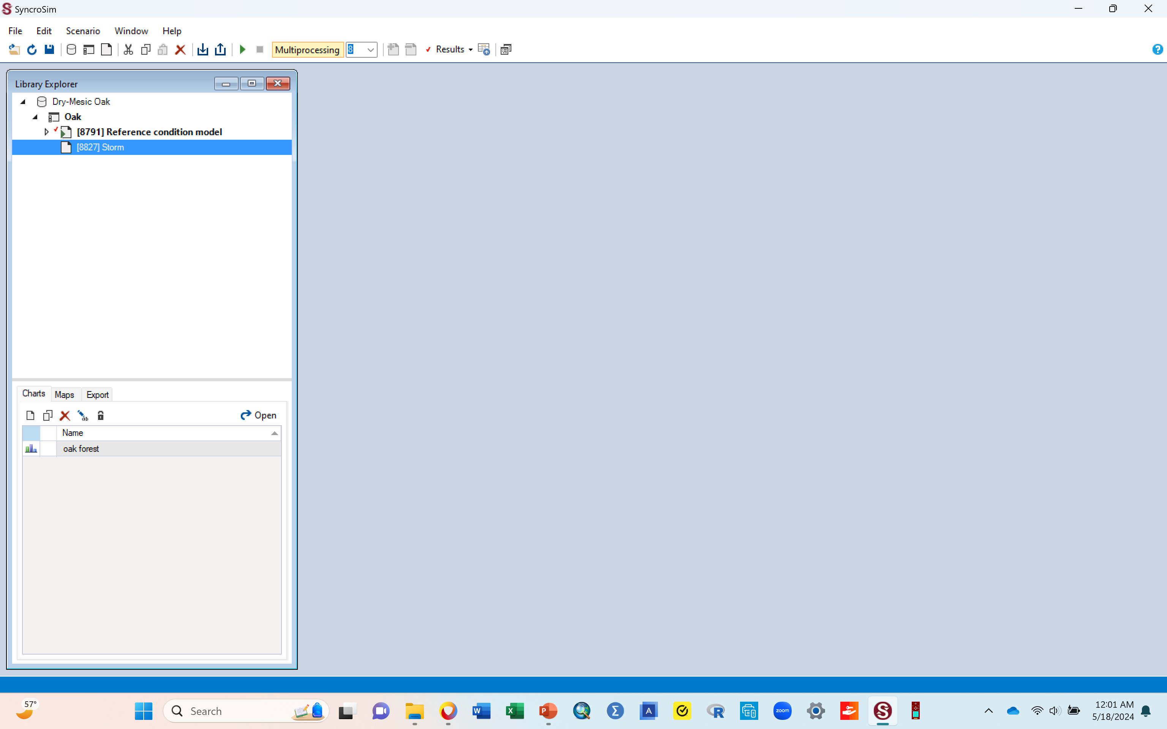
N. Create a new scenario with a new disturbance
Next, right click the new scenario, and in the box of options that come up, click rename.
In the box that follows that, type in “Storm”. This renames your new scenario as storm. We are naming it storm because the disturbance we want to introduce is a storm. You can give your disturbance whatever name reminds you what disturbance you are introducing.
When done, your screen should look similar to the one below image.
Go to the next slide to continue.

Slide 38
O. Now introduce a disturbance
Some information to know
To introduce disturbance, you will need to bring up the scenario pane (for your new scenario), just as we did with the original scenario.
You will then use the content of the Transition pathways diagram to make changes that reflect the type and characteristics of this new disturbance.
Follow the steps on the next slides to do that

Slide 39
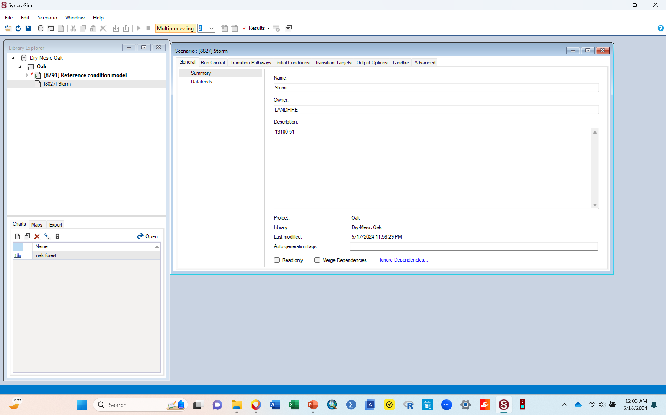
O. Introducing a disturbance
First, open the scenario pane for the Storm scenario
Double click the “Storm” scenario and that should bring up the scenario pane, similar to the one shown below
  Remember: you can drag the pane to the right so it is right next to the library pane, and you can extend the pane downward so it is larger.
  Your screen should look similar to the one below when done.
  Go to the next slide to continue

Slide 40
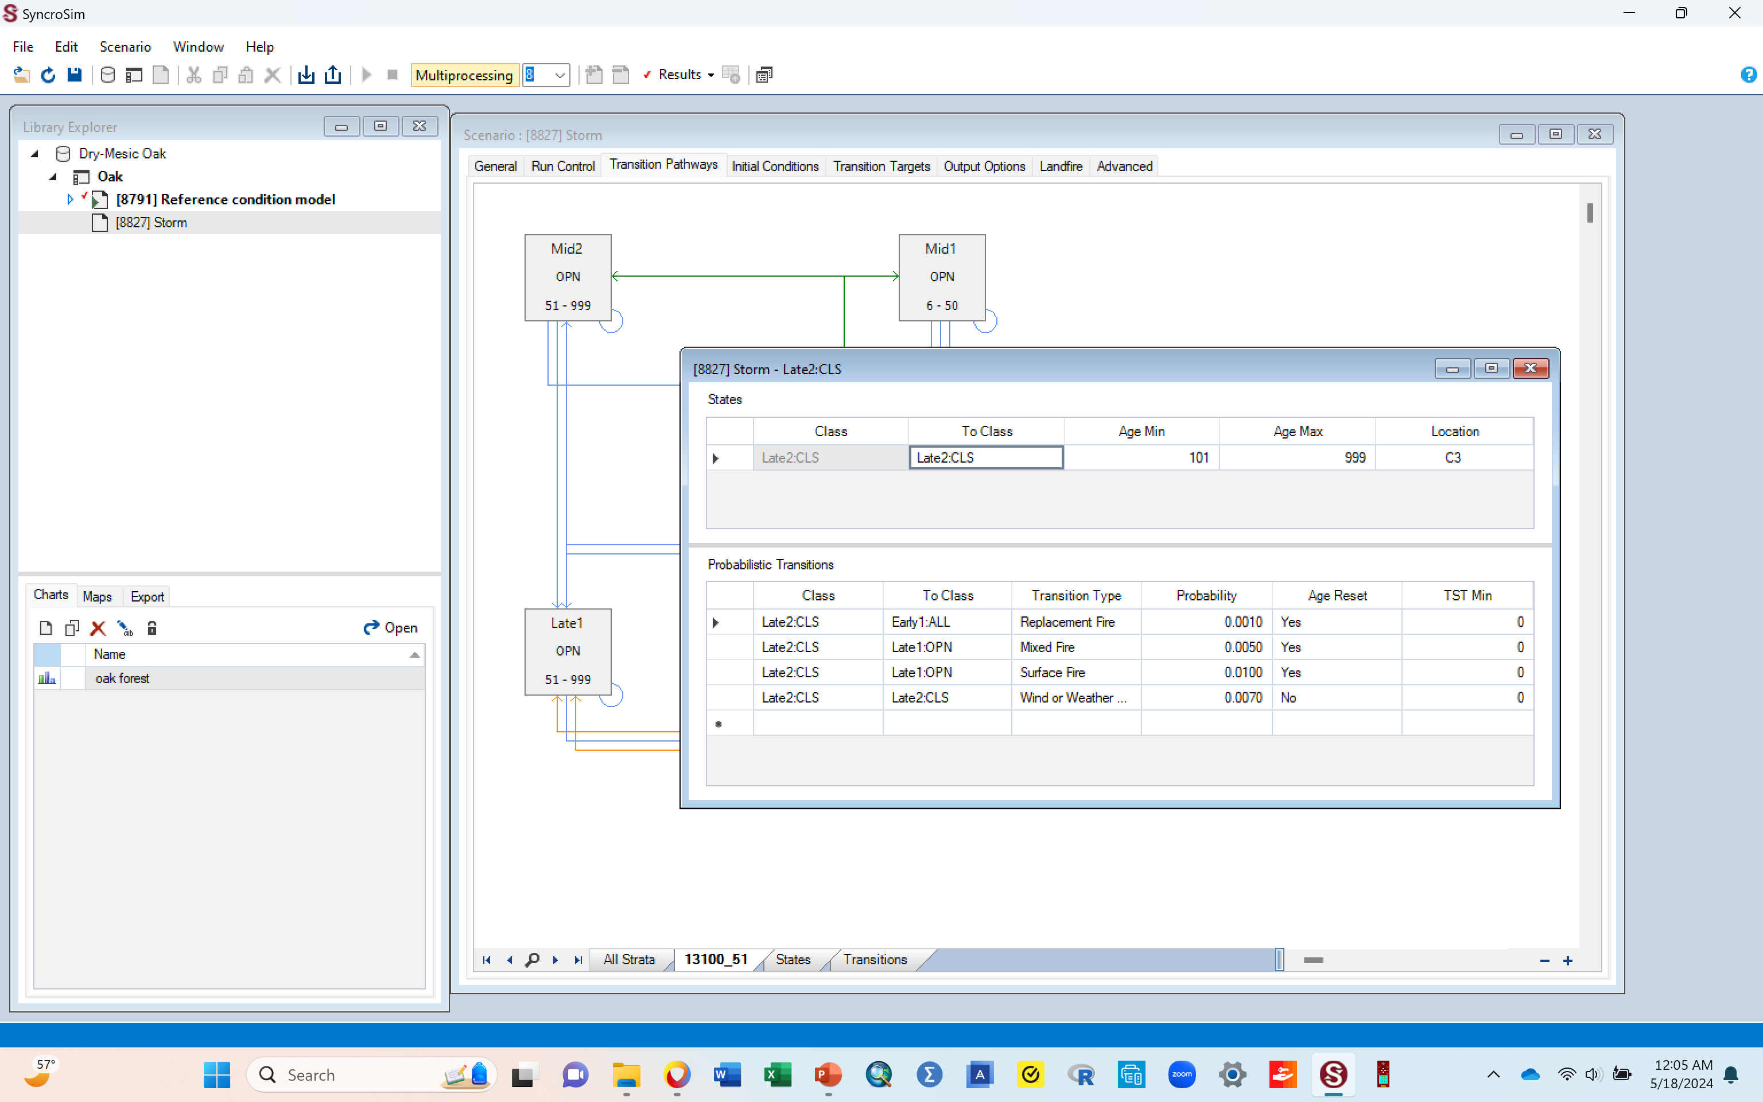
O. Introducing a disturbance
Next, you want to change the details of the “Transition pathways” diagram using its Probabilistic Transition table (a table that you can edit).
Click the “Transition pathways” tab to display the diagram of the state classes.
Within the diagram, double click the box for “Late 2 CLS”. This will bring up a probabilistic transitions table (the table shown in the image below that’s on top of the pathways diagram).
  You are clicking this successional stage (Late 2 CLS) because when introducing a new disturbance, you click the successional stage that you want your disturbance to move the system from.
  E.g., if moving the system from Mid 2 OPN to early 1 All, to get the table, you double click Mid 2 OPN in the transition pathways diagram.
  In this case, you want the disturbance to move this ecosystem from Late 2 CLS to something else, so you double click Late 2 CLS, i.e., the one you are moving it from.
Your screen should look similar to the one shown below.
Go to next slide to continue

Slide 41
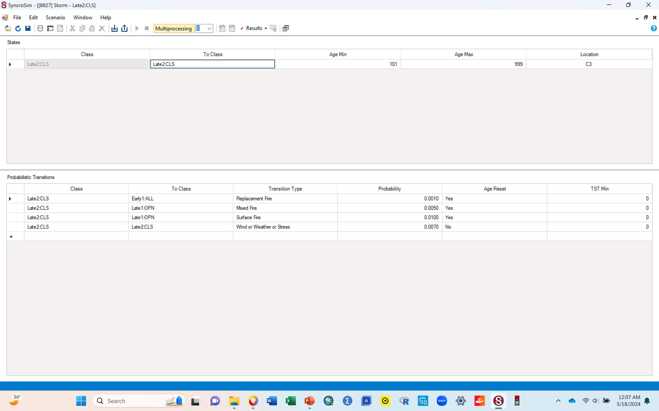
O. Introducing a disturbance
Next, you want to set up the characteristics of your new disturbance in the probabilistic transitions table that you just brought up in the previous step
Maximize the table by clicking the little box at the top right corner next to the red X button. This will help you see the content of this table better
When done maximizing, your screen should look similar to the one below.
Go to next slide to continue

Slide 42
O. Introducing a disturbance
Within this table, there are two sections; the top section (labeled A below), and the bottom section (labeled B below) that says probabilistic transitions in the first row.
For purposes of this activity, you want to leave the top section (labeled A) alone, so do not change anything in this section. You only want to make changes in the probabilistic transitions section (section labeled B)
Go to next slide for steps to make these changes
A
B

Slide 43
O. Introducing a disturbance
In section B (the probabilistic transitions table), there will be several rows (arranged by column) with text data already entered. BUT, there should be one or two rows at the end, that are completely empty with nothing in them.
We want to enter our data in an empty row that have nothing in it already. We do not wan to click any of them rows with data in them or change their content. We want an empty one so go to that.
In the empty row, under the column “class”, click the first empty cell and it will automatically fill that box in with Late 2 CLS. Once it does that, leave it as is. This indicates that we are asking the disturbance to move the system from this successional stage.
Next, the cell in the column “to class” will already be filled. Click this cell and it will have a dropdown arrow to the bottom. Click this dropdown arrow in it and among the classes shown, select “Early1 All”.
  You are telling the model that you want the disturbance to impact the system in such a way that Late 2 closed succession stage will be reduced (move from), and instead the disturbance should provide opportunity for increase in early 1 succession stage (early 1) that has a mixed canopy structure (All).
  This is like saying that you are asking the disturbance to specifically target moving the ecosystem from late 2 closed to more of early 1 All, even though you know that all the other classes are likely to be impacted as well during this process. So, don’t get hang up thinking only the selected classes will change. We are just giving it direction by putting in particular things that we would like.
Under the “transition type” column, click the empty cell, then click the dropdown menu in it, and then select “Wind/weather/stress”. This means that, out of the types of disturbances given in that list, this is the category you have determined to best represent the disturbance (storm) that you are introducing into this ecosystem.
Keep going with your table on the next slide

Slide 44
O. Introducing a disturbance
Under “probability” column, type in 0.2000.
  This sets the disturbance return interval. You are saying that you expect the storm to be returning to this ecosystem every 5 yrs.. So, in probability terms, you divide 1 by the 5 to get 0.2000 that you put in this box. We always put the return interval value in here in the form of a decimal.
    This means that for any disturbance you work with, you need to know its return interval in years. Then use that number to calculate the probability for it, which is what you enter in this box
    For example, if return interval is filled 10 yrs., you divide 1 by 10 to get 0.1000, which is what you enter in this column.
    Probability is always in decimal form, so you must change your return interval (10 yrs.) into a decimal format (0.1000)
For the “Age reset” column, click the cell and select Yes from the dropdown.
  You are saying that you want the disturbance to reset the ecosystem to the lowest number in the age range of the class it is being moved to. In this case, because you are moving it to early 1 all (a stage that lasts 0 to 5 yrs.), by clicking Yes on age reset, you are asking for the ecosystem to go back to 0 (the lowest number in the 0 - 5 age range)
  For each disturbance you work with, you will have to decide if you want the system to reset the age or not (Yes or No for this column)
For the TST Min, enter zero, similar to the rows before it.
  TSTmin stands for Time Since Transition minimum. This means that the transition (i.e., disturbance) can only be applied after the minimum number of years. In this case, those number of years are zero.
Go to next slide to see your completely filled in table.

Slide 45
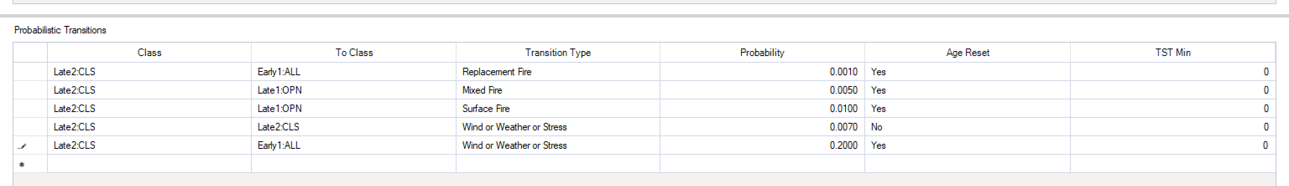
O. Introducing a disturbance
You should now have the table filled out, similar to the one below, with the showing the row you just filled in
Click the save icon at the top left corner of the syncroSim window to save your work.
Do not leave this part without saving, you will lose all of the things you have told this model to do!
Go to next slide for instruction on how to exit this table

Slide 46
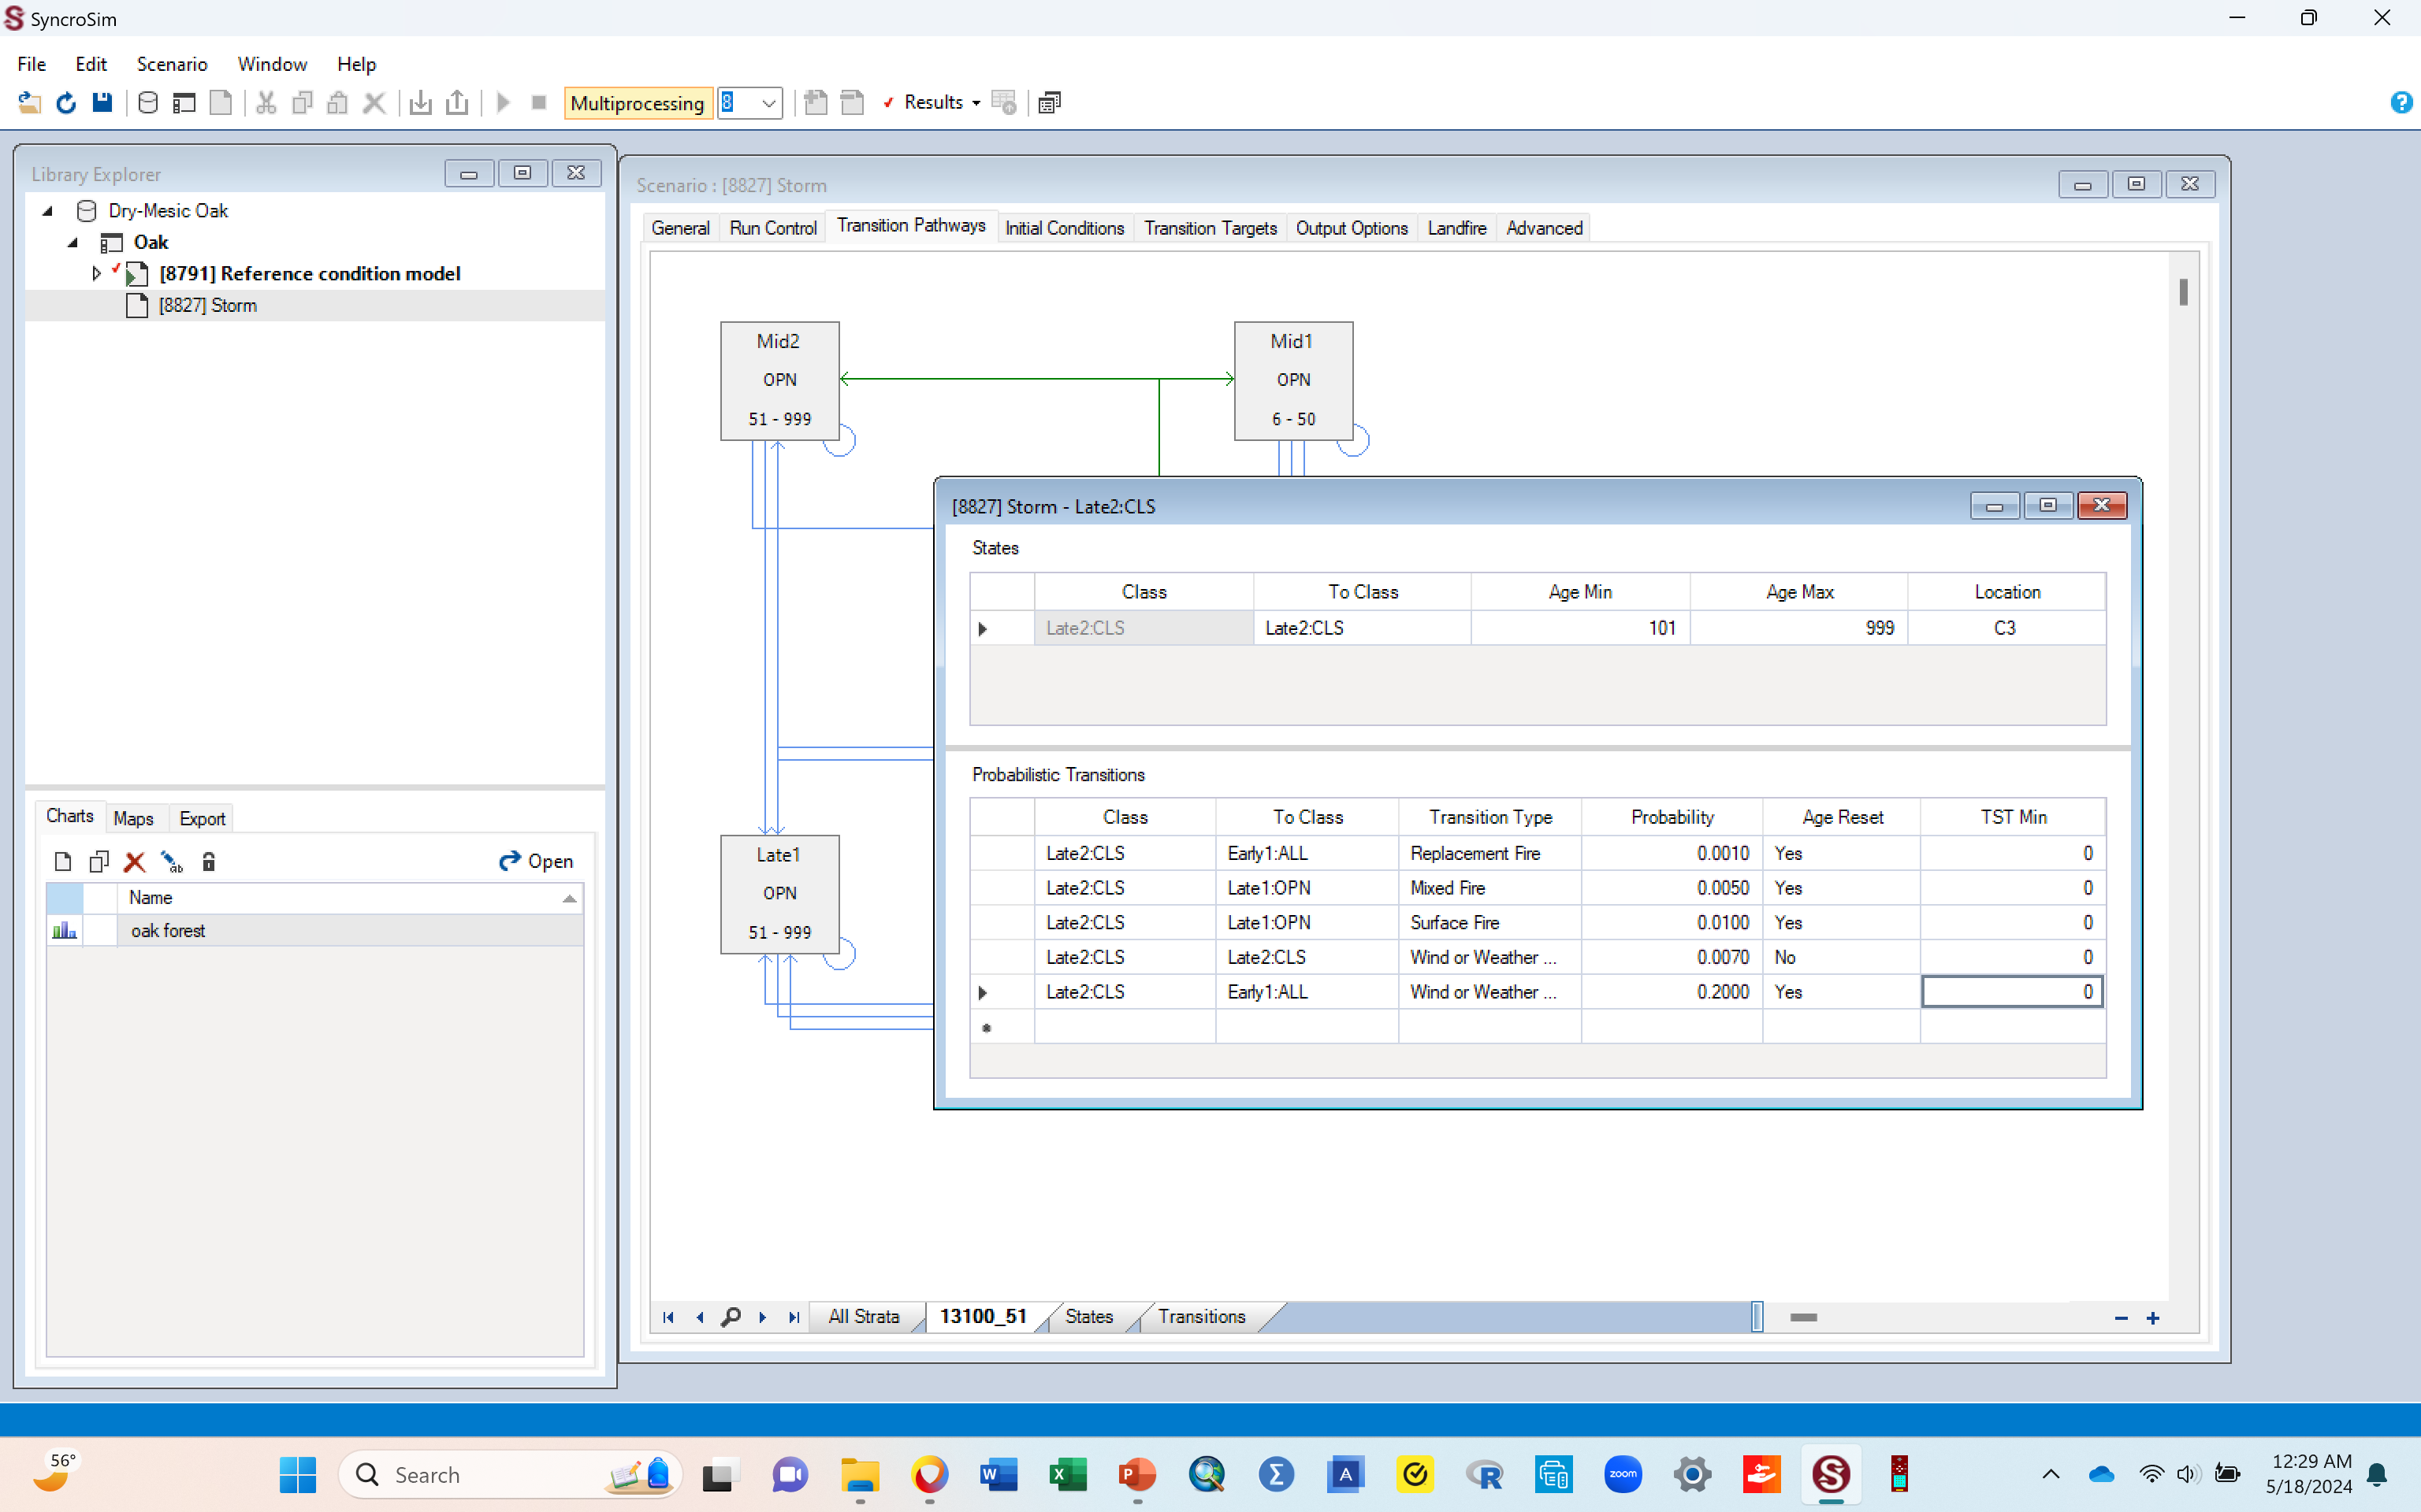
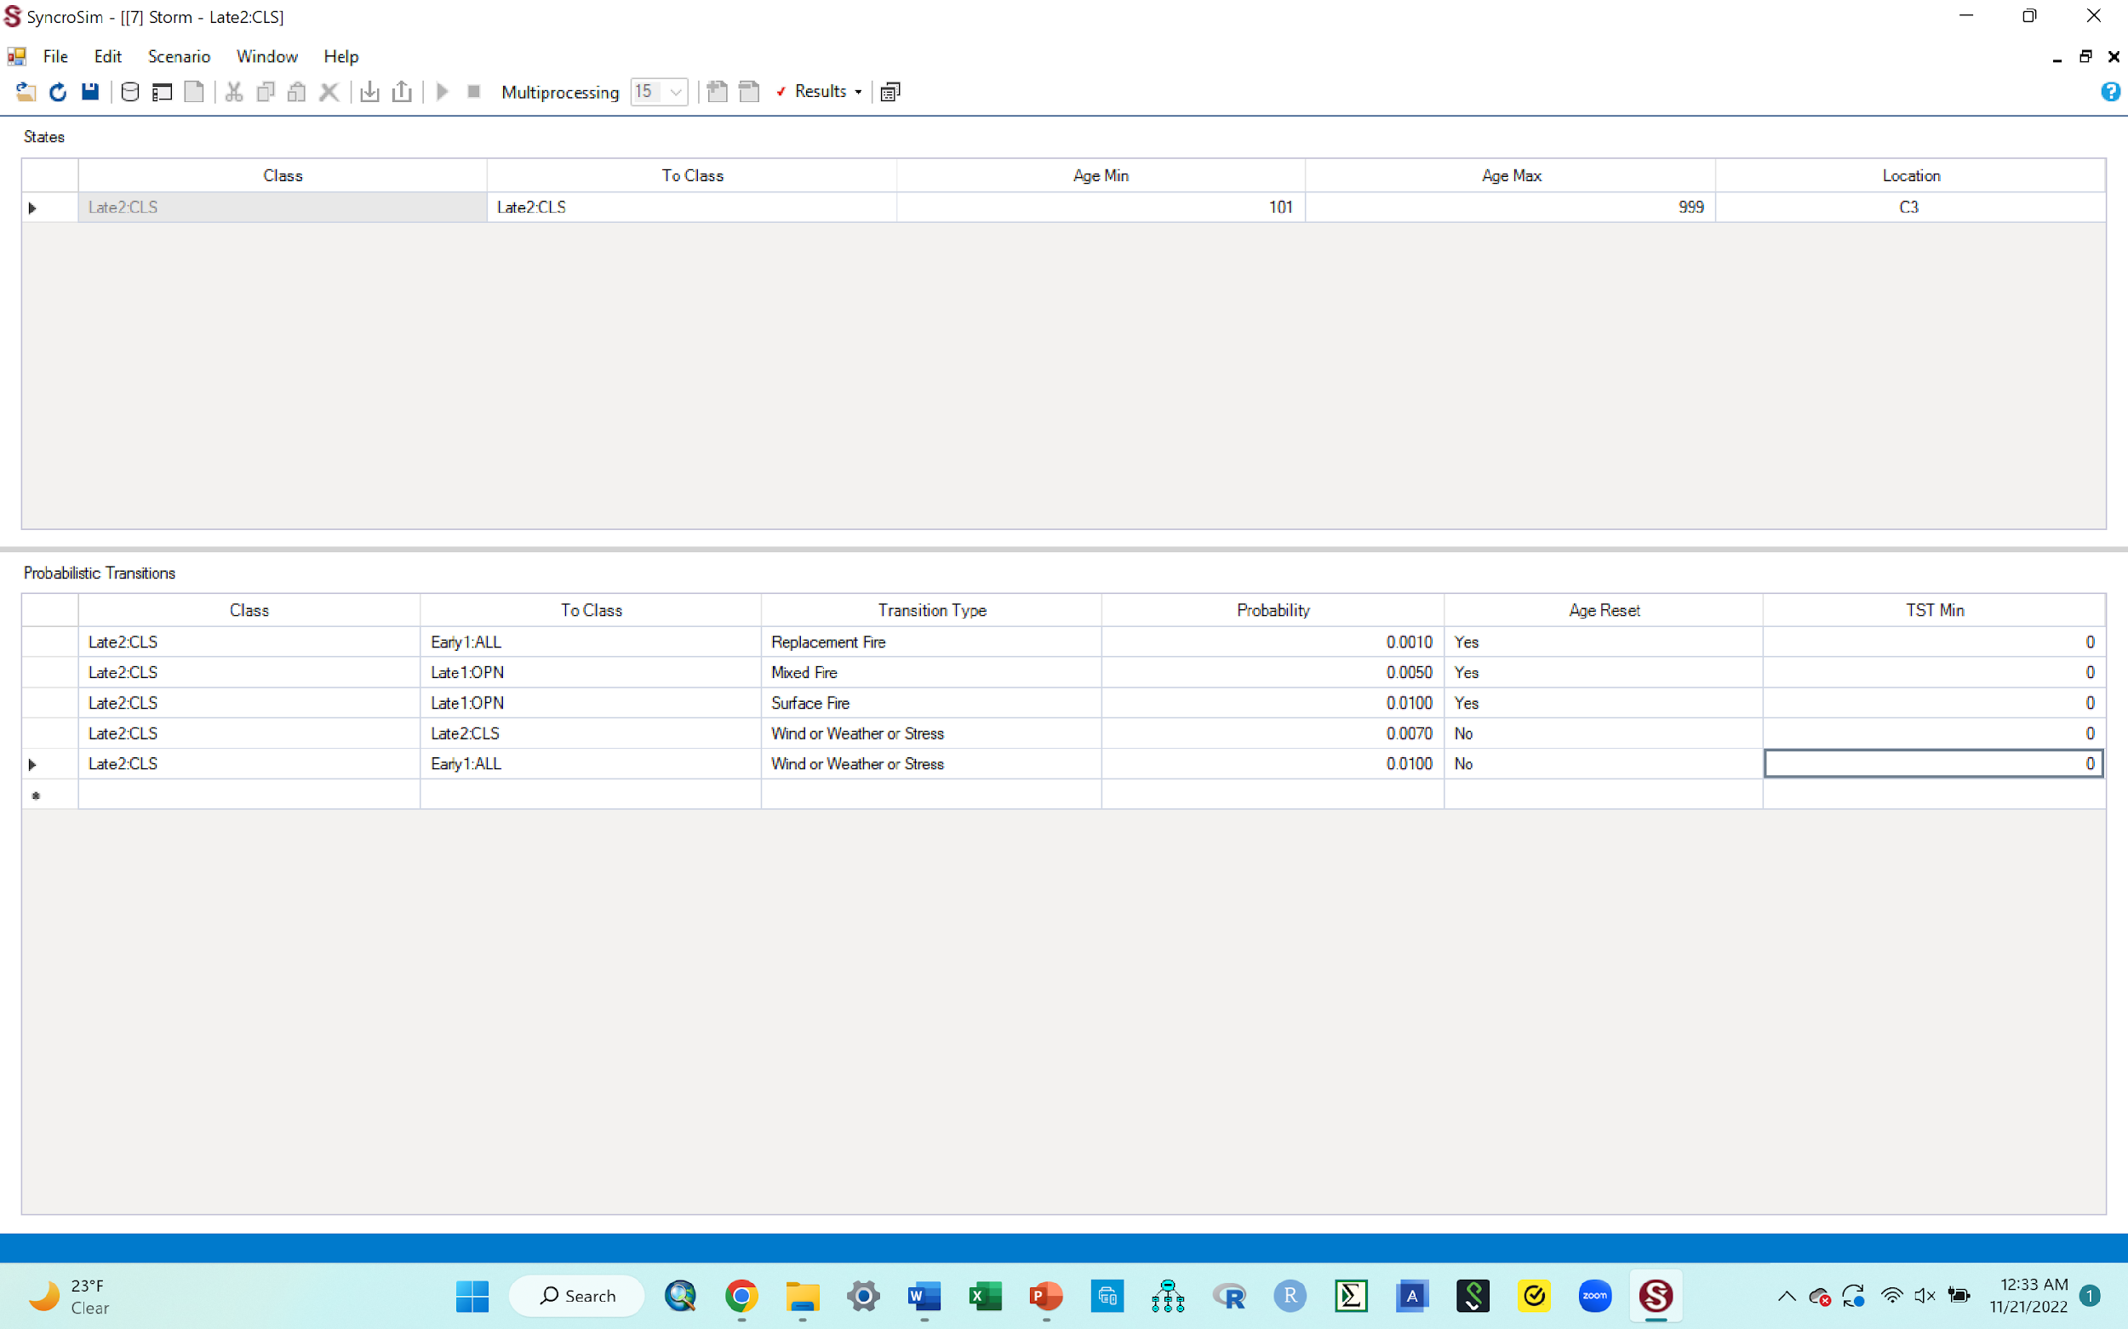
O. Introducing a disturbance
Now we want to exit out of the probabilistic table so we can run the model
After saving, first minimize the table by clicking the middle set of boxes in the top right corner (shown by the dotted circle). You need to do this minimizing step to avoid clicking the wrong tab that could delete your whole work window.
That will bring you back to the table and the pathways diagram as before (2nd image to the right).
To exit the table, click on the red X tab to its right corner.
That will leave you with the scenario pane that has the transition pathways diagram.
Click save again and them click the red X tab on the top right hand corner of this pane to exit it as well.
Go to next slide to see what you have now.

Slide 47
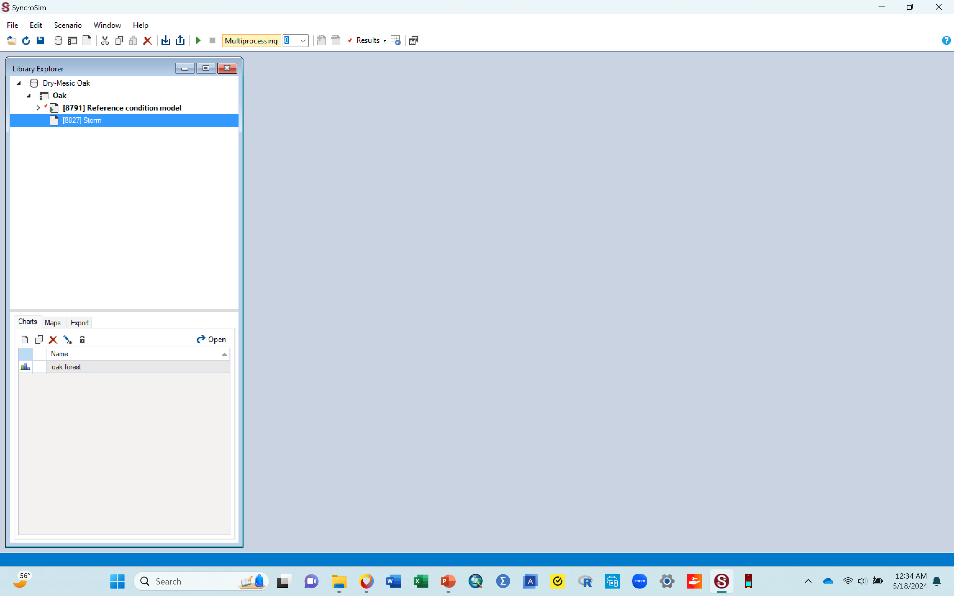
O. Introducing a disturbance.
Your workspace should now look similar to the one below after exiting the table and the scenario pane in the previous step.

Slide 48
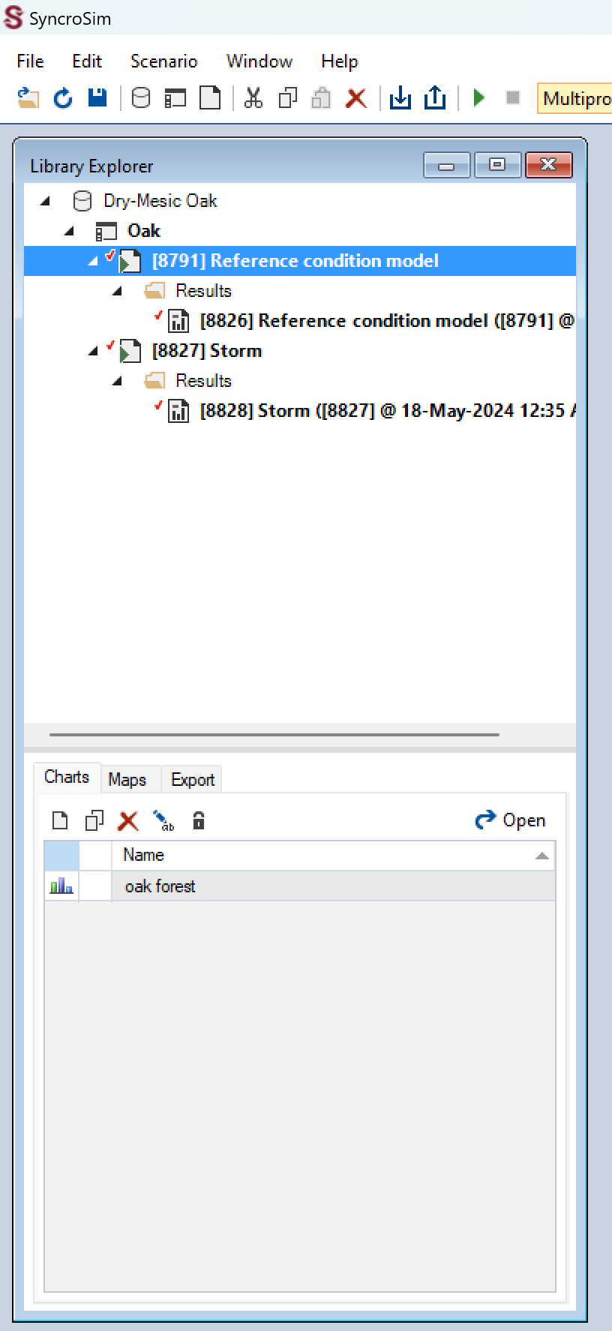
O. Introducing a disturbance
Now you want to run the model, just like you did before, to enable you to get a new graph
Click the “storm” library once to highlight it, Right click then select the green “Run” option, just like you did before.
A run monitor window will pop up to show progress and it could be fast, just like before
When done, get out of that run monitor window by clicking the red X button on the top right corner of that window, just like you did before
Double check to ensure that there is only one line of results for your original scenario, and one line of results for the new storm scenario, just as shown in the dotted circle area in the figure below.
Go to next slide to produce a new graph showing what your disturbance did to the successional classes

Slide 49
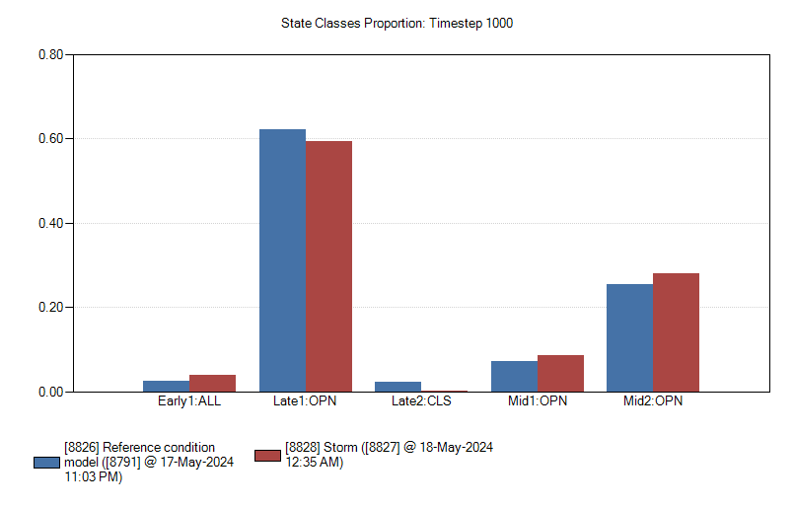
P. Finally, produce a graph of results for your storm disturbance
Produce a new graph just like you did previously
Double click the “oak forest” chart, and out should pop a new graph!
  This graph should have two bars for each successional stage. Blue and red
  It shows you the proportion of the ecosystem that is made up of each succession stage, before the disturbance (the blue bars) and after the disturbance (the red bars)
  The blue bars are the original bars you had in the first graph you made. These should never change since it is our baseline
  The red bars represent the new classification of successional stages, based on the result of the disturbance you introduced.
  Note: if you accidentally click inside of this graph, there will be a red vertical line that shows up at the location of the click. Although harmless, this line can be annoying once it shows up, so it is advisable to avoid clicking anywhere inside the graph. To remove it, you can just click anywhere outside of the graph, and it should disappear. If that doesn’t work, you can just delete this graph, then double click the “oak forest” chart so a new graph can pop up again.
  Go to the next slide to copy your graph to your word document

Slide 50

Graph, yaay!!
Assignment # 3: Put the cursor in the middle of the graph, right click, select “copy to clipboard”, then paste in your word doc. Caption this graph as Figure 3. Storm
If you run into problems while producing this new graph or the graph itself does not look right as it should be in terms of bars, go to the next slide for suggested solutions.
If your graph worked out ok and you did not run into any issues producing it or the graph itself has the correct content in terms of bars, ignore the next slide and go to the one after it.

Slide 51
Q. Problem you may run into with your new graph
Sometimes, your new graph may have only 1 bar for each successional stage. If this happens
  click the save tab and exit the new graph.
  click the scenario for the disturbance you are working with to highlight it (e.g., storm)
  run it again.
  then come back and double click the “oak forest” chart.
  This should refresh your graph to show 2 bars per successional stage.
Other times, you may get a graph with two bars alright, but the results just do not seem like what you should get, or you are just suspicious. To address this, you can change the parameters you had entered in the probabilistic table and rerun the model for that scenario.
  Click the dropdown on your scenario (e.g., storm) to bring up the “results” line
  Right click this results line and delete it
  Double click the storm scenario to bring up the probablistic table where you had put the parameters of your disturbance into before.
  In the section where you had entered things before (section B), the line/row that you entered data in before will not be there anymore since you deleted results. You need to use the empty cell after the end of the ones with data in them to again enter your parameters, just like you did before, but with whatever new parameters you want to use
    You could for example change the return interval, so now instead of using 5 yrs., you use 10yrs or 3 yrs. Use that to calculate the probability that you enter in the probability column.
    You could change your choice for age reset or transition type, whatever makes sense to change.
    Typically, changing the value you put in the probability column (your return interval value) is sufficient to result in meaningful change, without needing to change parameters in the other columns.
  Click Save, exit the table, rerun the scenario. You must rerun the model after changing parameter in the table, otherwise you will get the same results you had before.
  Once completed, exit the run box, and double click the chart to display your new graph
If the bars for the original scenario do not show up, you can delete its results and run it as well. Might require you to make selections for the state classes, just as you did before.

Slide 52

R. Reminder explanations about what you are doing (knowledge cementing)
  Using the two bars in the graph, you are looking to see what the disturbance did to this ecosystem.
    The impact could be that the disturbance reduced or increased any of the successional stages.
    Ecologically, you expect a disturbances to change something/have an impact, right?
    There are various ways to examine such an impact, right?
    In this activity, you are examining that impact by looking at the changes it made to the succession stages e.g., did it reduce late 2 CLS and increase early 1 All? What did it do to the other succession classes?
    That is how this modeling activity helps you introduce a hypothetical disturbance to an ecosystem, and then see what the disturbance does to that ecosystem, as mentioned before. In this case, you are examining this change by looking at what the disturbance does to the different succession classes.
    Later on (with new disturbance that you will do), you will be asked to explain what you think happened that made the vegetation/ecosystem change the way that it did e.g., why do you think late 1 open decreased while mid 2 open increased? What could the disturbance have done to the vegetation to make this change happen?
    Explanations continue in next slide

Slide 53
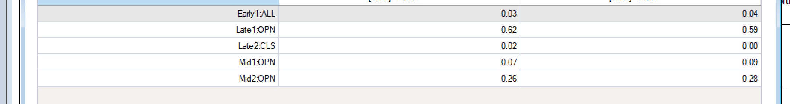
R. What if I would like to see the changes, in numbers, not just by looking at the bar heights?
To view the level of change for each succession stage in terms of numbers, do the following
While you have the graph up, put your cursor over any of the bars, right click and click “view data” in the selections given. This will give you a table similar to the one below, where you can see what the values were for your original scenario (the 8826 column) and what the values are for your disturbance scenario (the 8828 column), for each stage
You can also put your cursor over any of the bars, right click and select “export”. This will export the numbers for both the original scenario and the disturbance scenario into an excel file. This excel data cab be used later to make graphs.
Just note that the particular activity you are doing right now does not require you to export anything; the graph you made during this process is sufficient.
Now that you have modeled the impact of a storm as a disturbance, in the next section, you are going to model some additional disturbances, using the skills you have learned throughout this practice section

Slide 54
Part 3: Modeling the impact of other disturbances on this ecosystem, using the steps learned with the storm practice disturbance

Slide 55
Modeling other disturbances using the steps you just learned with the storm disturbance
        Do not delete the [8791Reference condition models scenario or its results. It has your original succession classes (blue bars) in the results and those need to show up as part of any new disturbance graph you make.
        Do not run the original model (8791Reference condition models) again, unless absolutely necessary. At this point, you should not need to run it again!. As long as you leave it in place, it retains the first run you made on it and its results, so your original blue bars should still show up in the new graphs that you will make. If for some reason you delete it, you must run it again so you can have your original blue bars, before doing your next disturbance
        Delete the storm scenario before starting your next disturbance. Too many scenarios (for multiple disturbances) in your workspace can make you copy the wrong scenario when creating a new disturbance. Always delete the scenario (disturbance) you are done with, before creating a new one.
        Use the instructions given in the document with additional disturbances (Supplemental material 4) to model additional disturbances and answer questions for each.
        Follow assignment instructions given by your instructor to turn in the required assignments for this activity. This will be the word document where you paste all your graphs and respond to all questions given
Find the additional disturbances document in supplemental material 4 and follow the instructions in there and the skills you have learned so far, to model some new disturbances.

